Slide 1
Using Auto-Regression to Predict Molecular Forces
Birk Nøhr Dissing

Slide 2


What is MD?
Simulate the dynamics of molecules
Can be thought of as a virtual laboratory
Allows exploration of timescales and systems otherwise not possible

Slide 3




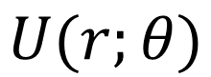
How to do MD?
$$U(r;θ)$$
Classical MD:

Slide 4


How to do MD?
Ab initio MD:

Slide 5
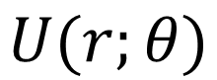
$$U(r;θ)$$
Classical MD:
Ab initio MD:

Slide 6
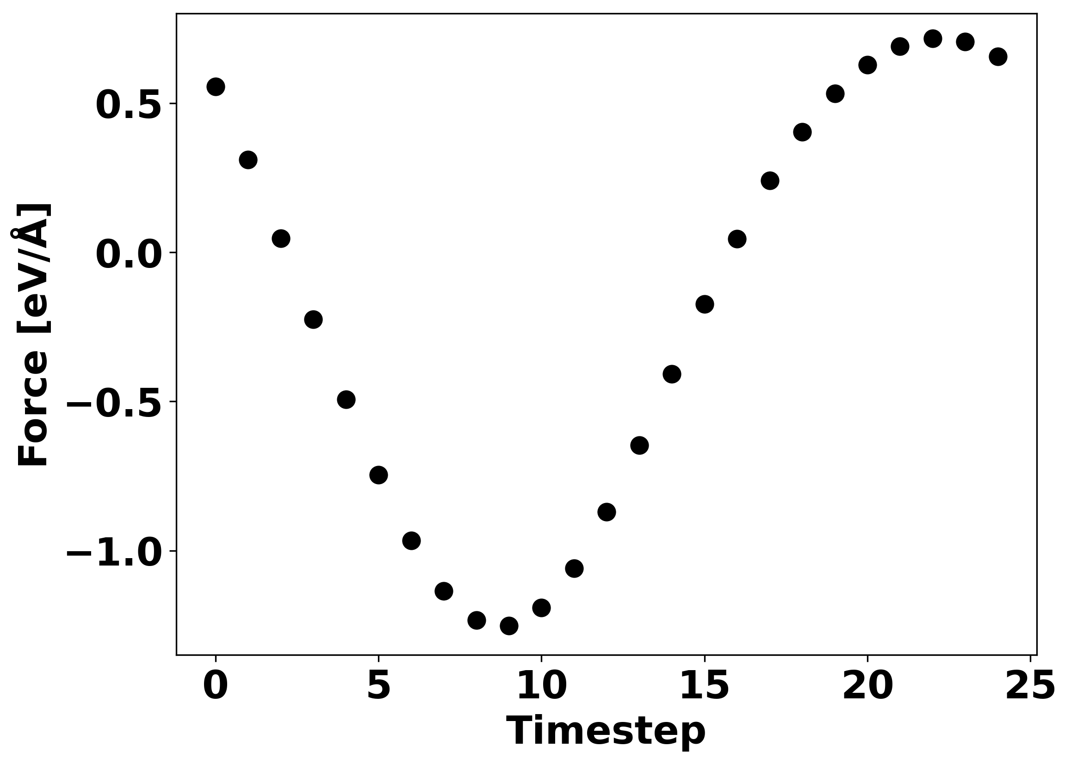
Idea
Speed up simulations by not calculating all forces.

Slide 7
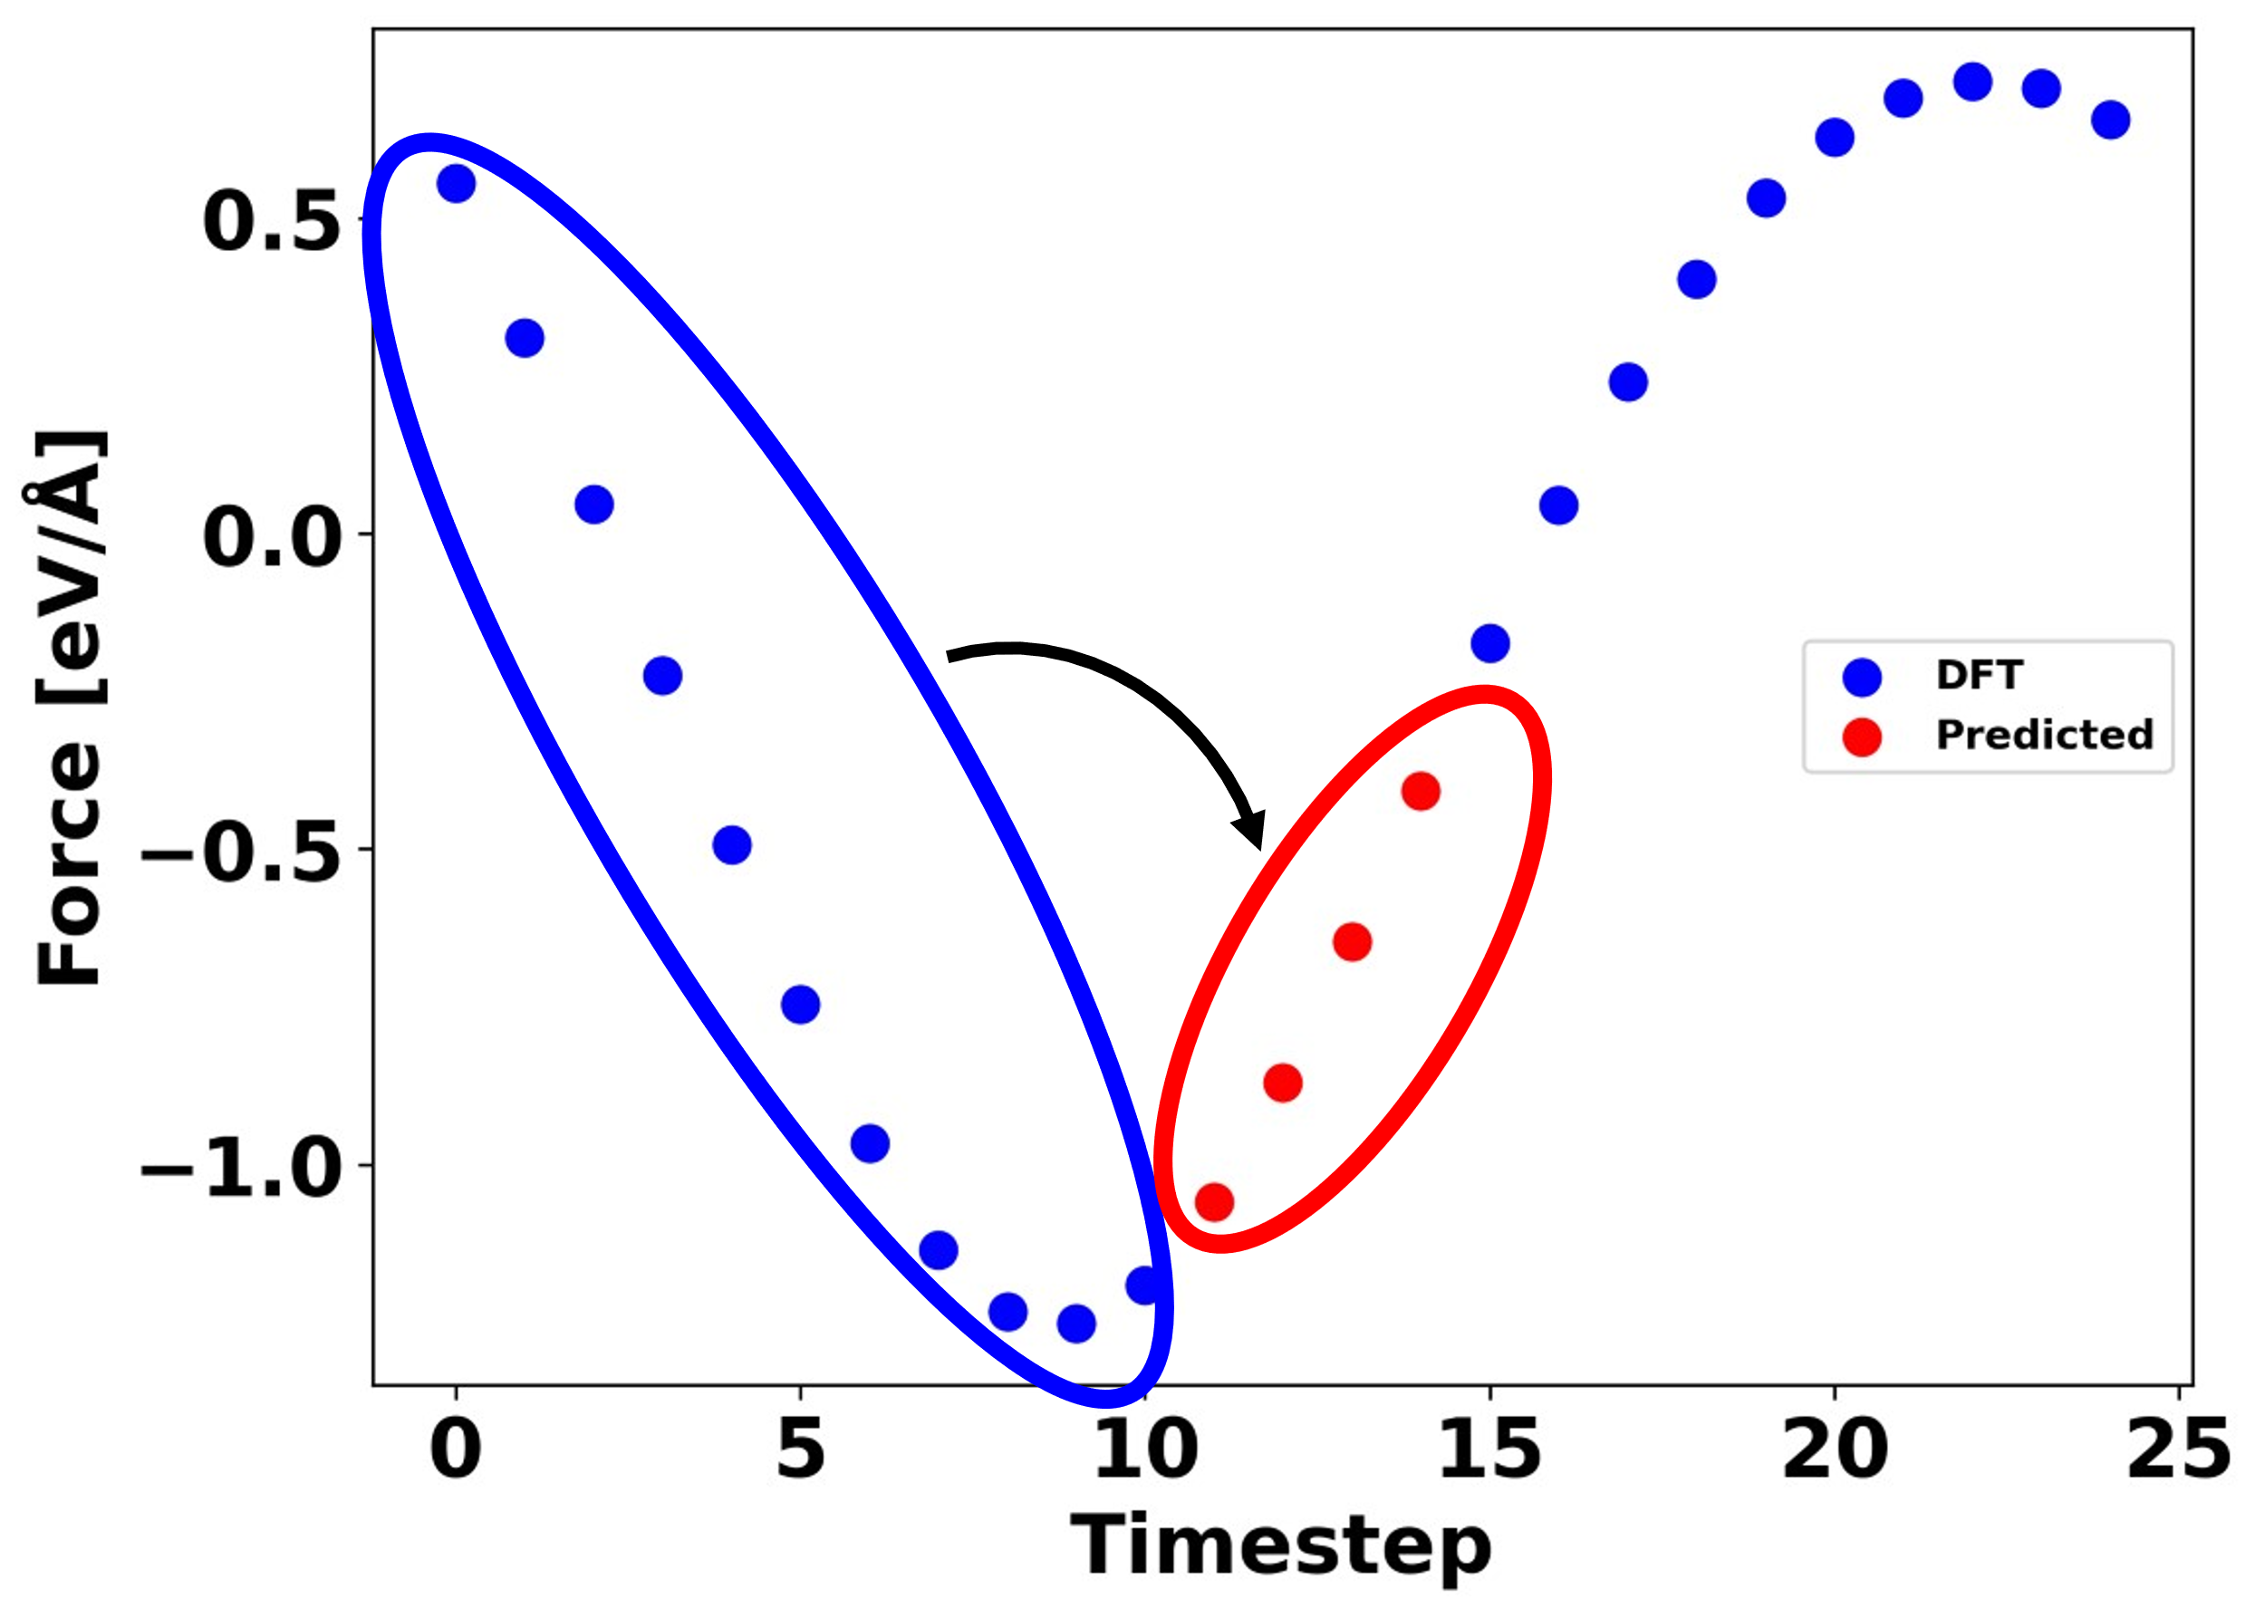
Idea
Speed up simulations by not calculating all forces.
Can we use a model to predict future forces based on past forces?
Brutovsky et al. published two papers in 2003 and 2005 predicting non-bonding forces.
doi: 10.1063/1.1559033
doi: 0.1016/j.cpc.2005.03.076

Slide 8
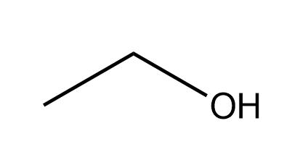
Simulation system
Ethanol in gas-phase
Simulation done using ASE and GPAW
dt = 0.5fs
xc = PBE
basis = sz
Velocity Verlet dynamics
Maxwell-Boltzmann distribution at 400K

Slide 9
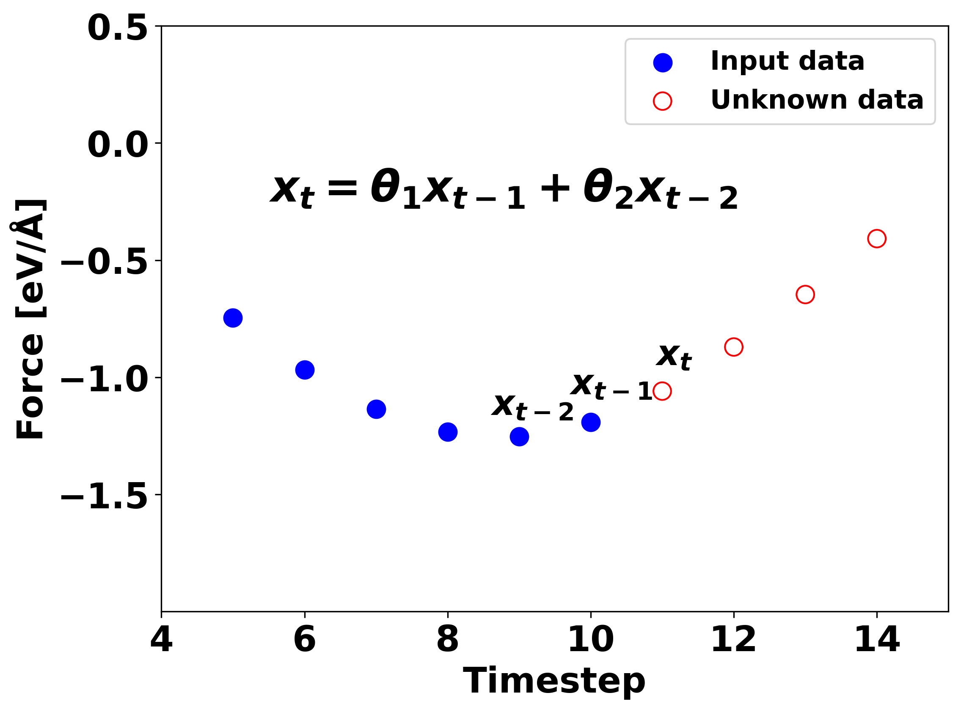
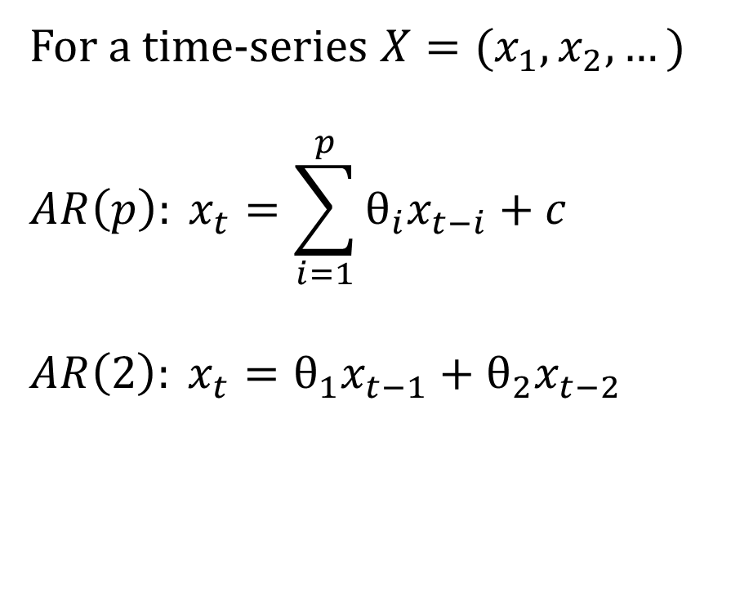
Auto-Regressive models
For a time-series $X=(x_{1}, x_{2},…)$
$$AR\left(p\right): x_{t}=\sum_{i=1}^{p}{θ_{i}x_{t−i}}+c$$
$$AR\left(2\right): x_{t}=θ_{1}x_{t−1}+θ_{2}x_{t−2}$$

Slide 10
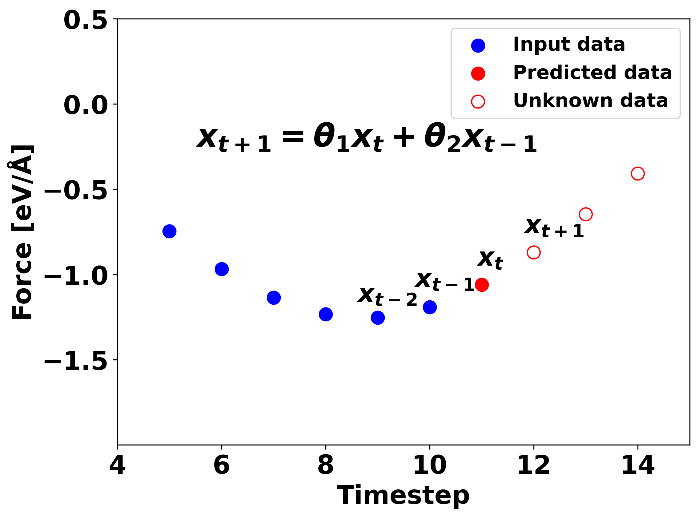
Auto-Regressive models
For a time-series $X=(x_{1}, x_{2},…)$
$$AR\left(p\right): x_{t}=\sum_{i=1}^{p}{θ_{i}x_{t−i}}+c$$
$$AR\left(2\right): x_{t}=θ_{1}x_{t−1}+θ_{2}x_{t−2}$$

Slide 11
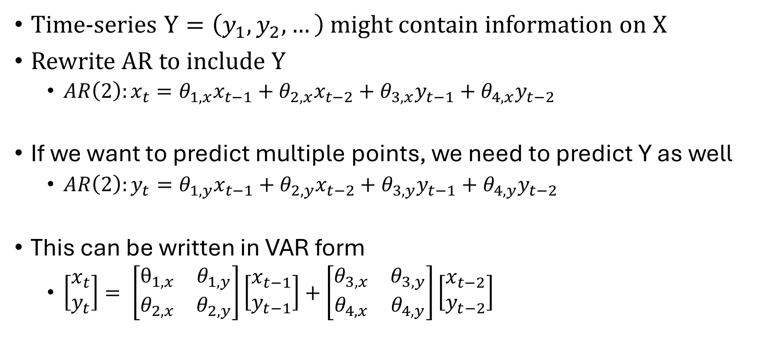
VAR
Time-series $Y=\left(y_{1}, y_{2},…\right)$ might contain information on X
Rewrite AR to include Y
$AR\left(2\right):x_{t}={θ_{1,x}x}_{t−1}+{θ_{2,x}x}_{t−2}+{θ_{3, x}y}_{t−1}+{θ_{4, x}y}_{t−2}$
If we want to predict multiple points, we need to predict Y as well
$AR\left(2\right):y_{t}={θ_{1,y}x}_{t−1}+{θ_{2,y}x}_{t−2}+{θ_{3, y}y}_{t−1}+{θ_{4, y}y}_{t−2}$
This can be written in VAR form
$\left[\begin{matrix}x_{t} \\ y_{t}\end{matrix}\right]= \left[\begin{matrix}θ_{1, x} & θ_{1, y} \\ θ_{2, x} & θ_{2,y}\end{matrix}\right]\left[\begin{matrix}x_{t−1} \\ y_{t−1}\end{matrix}\right]+\left[\begin{matrix}θ_{3, x} & θ_{3, y} \\ θ_{4, x} & θ_{4,y}\end{matrix}\right]\left[\begin{matrix}x_{t−2} \\ y_{t−2}\end{matrix}\right]$

Slide 12
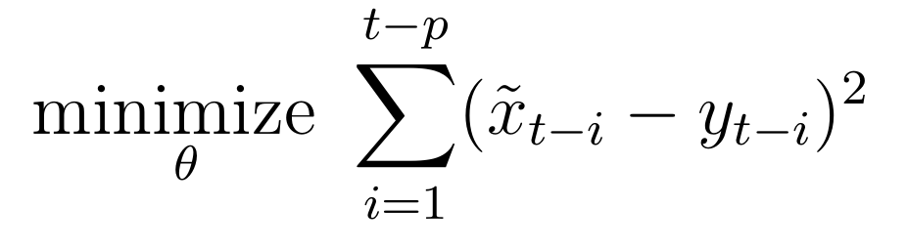
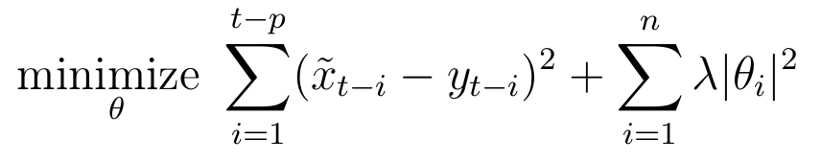
Fitting parameters
Least squares fitting
Tikhonov regularization
Solved using SVD

Slide 13
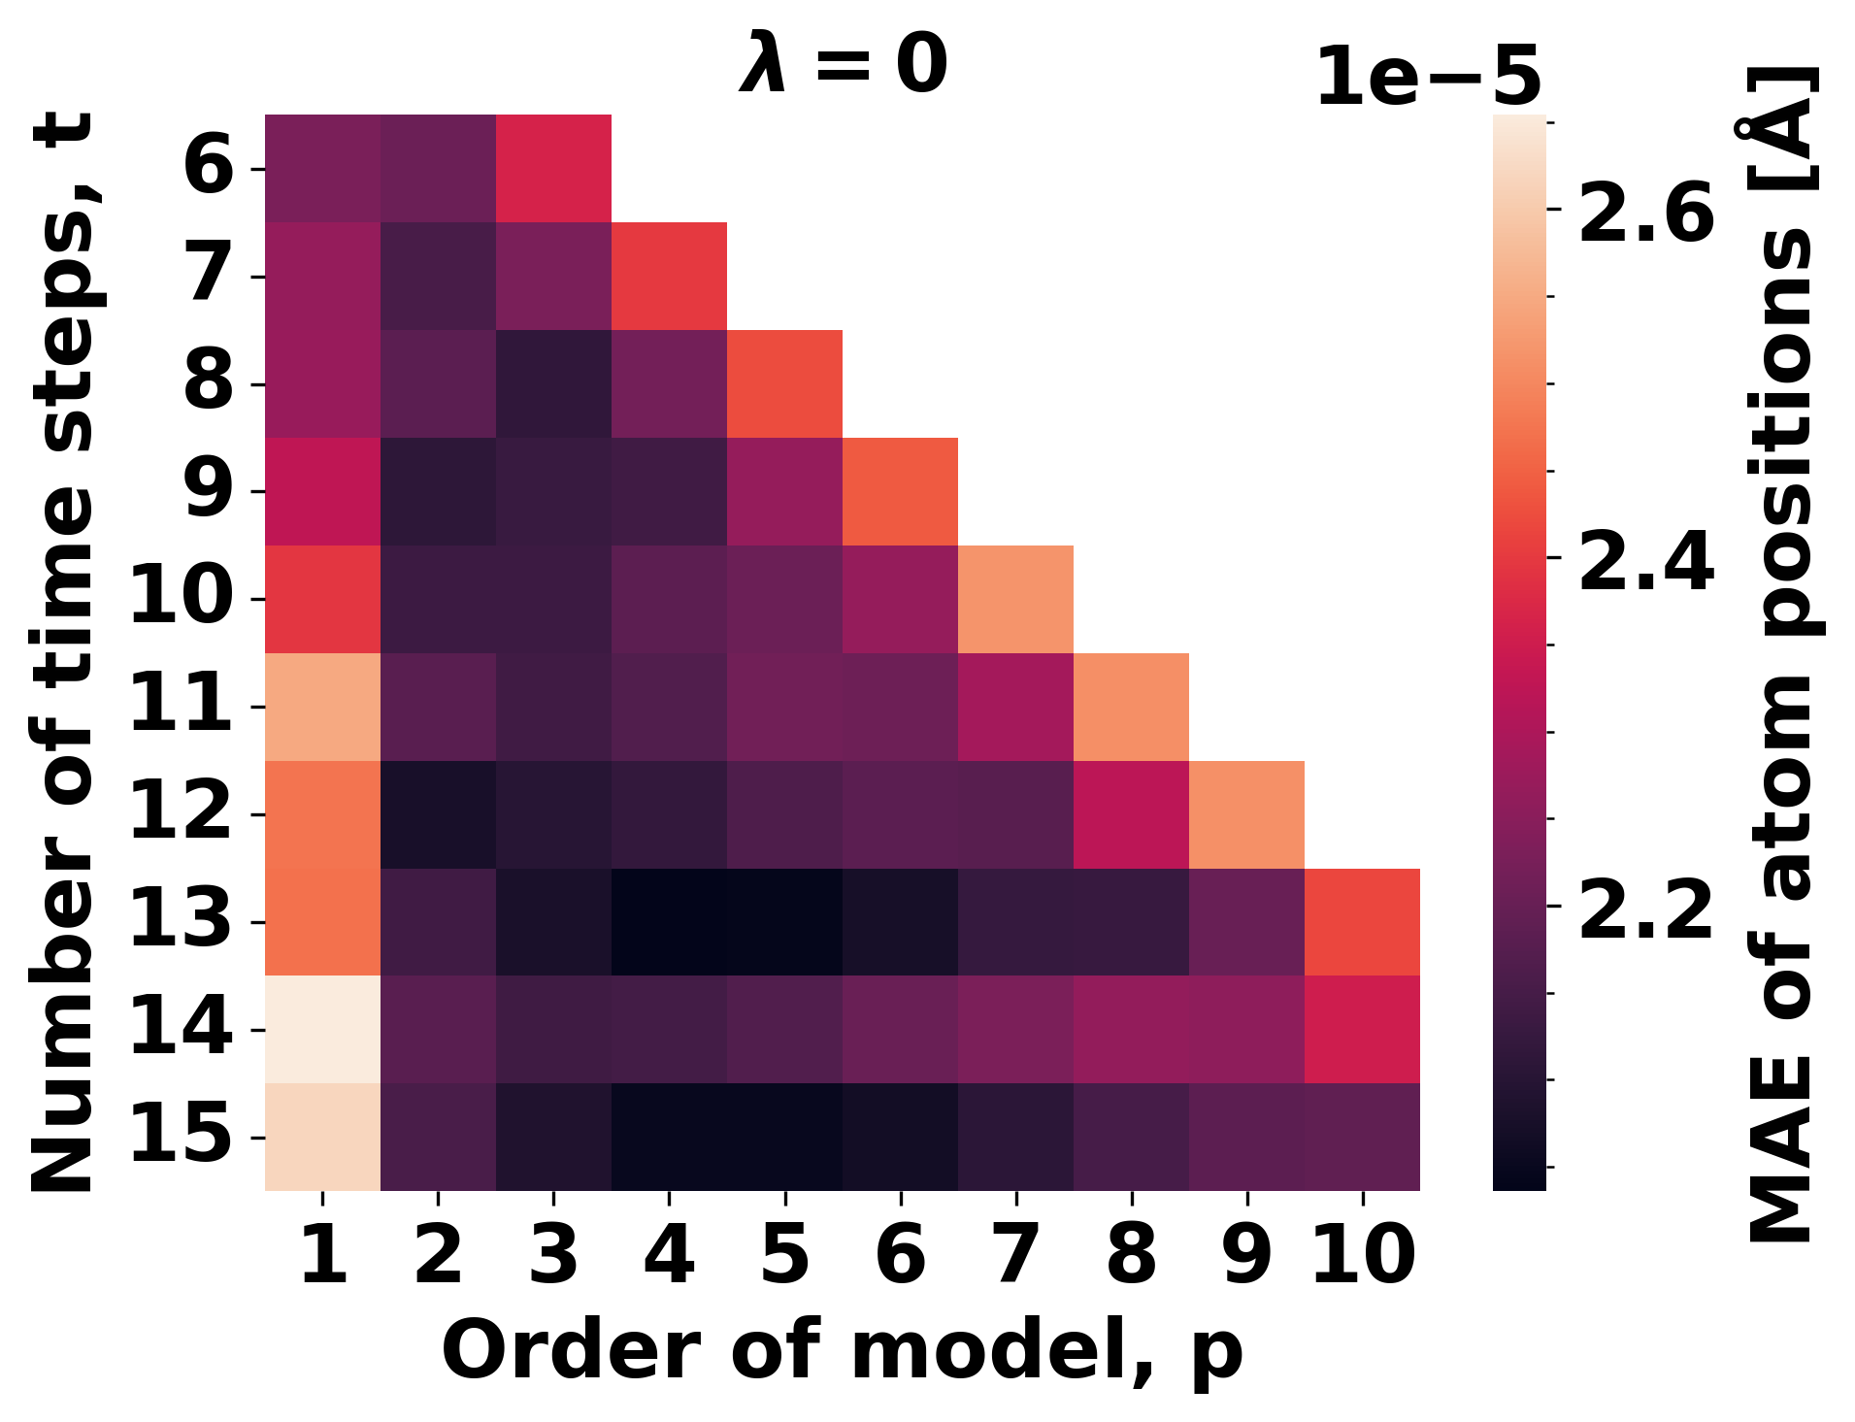
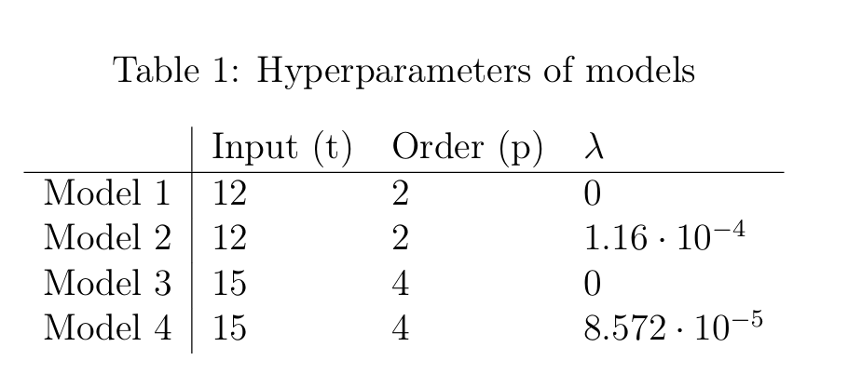
Hyperparameter Optimization

Slide 14
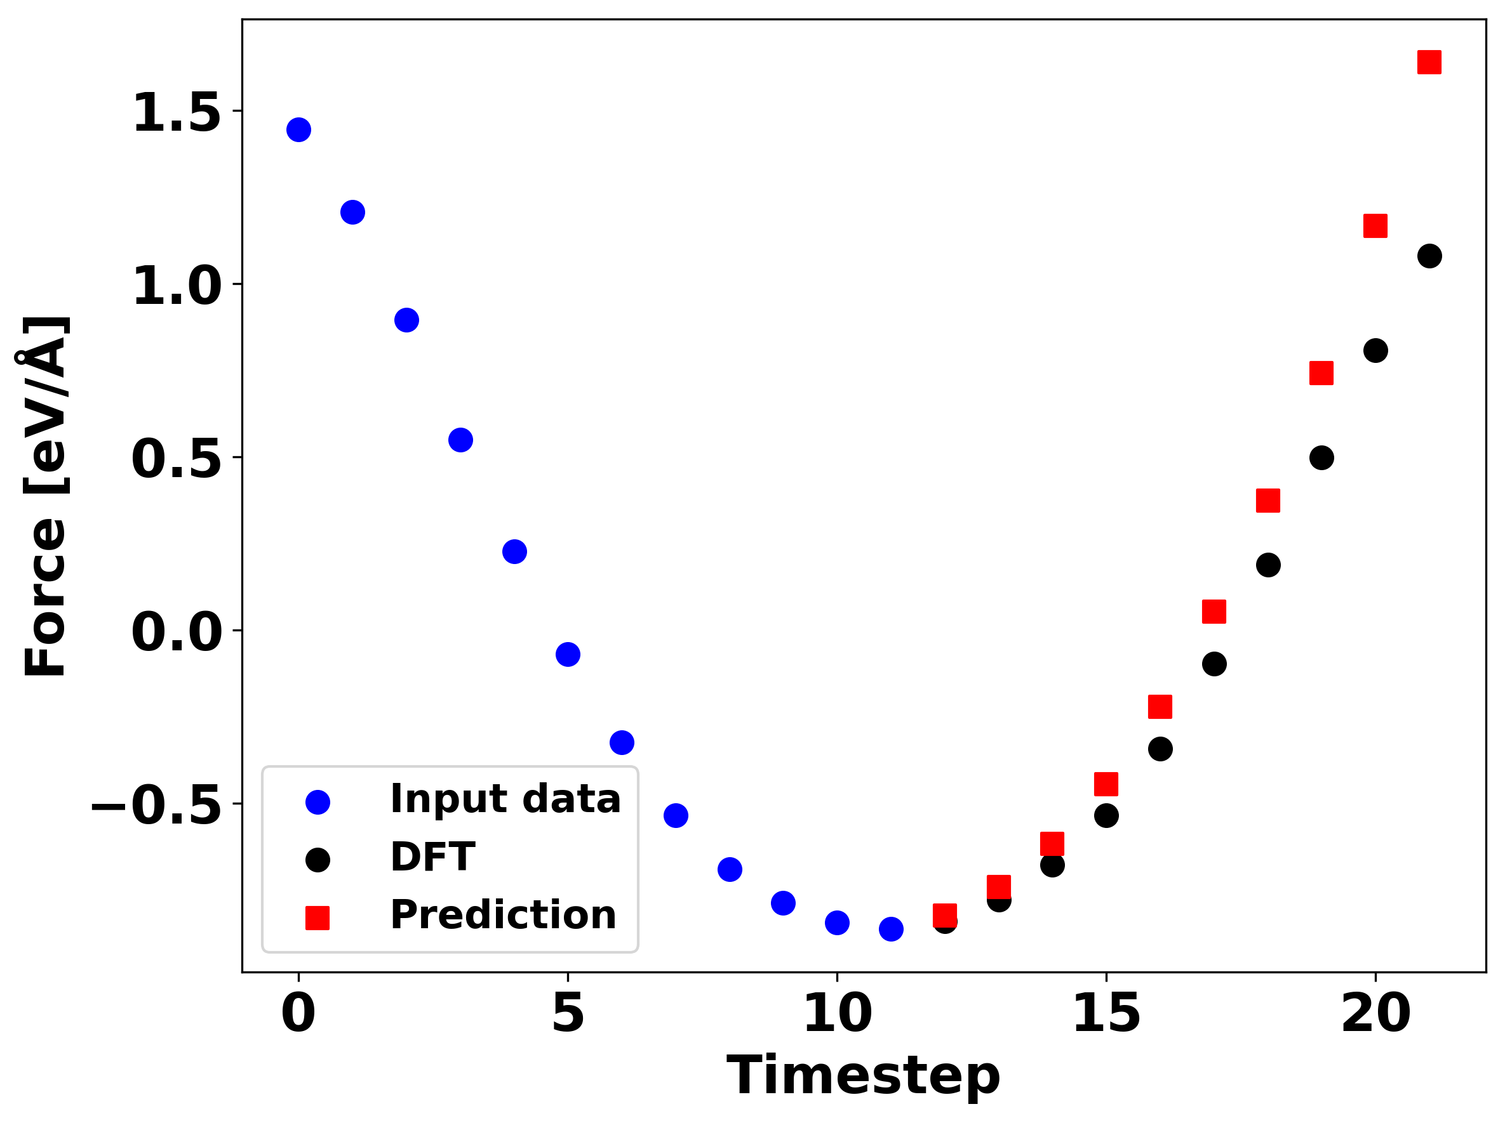
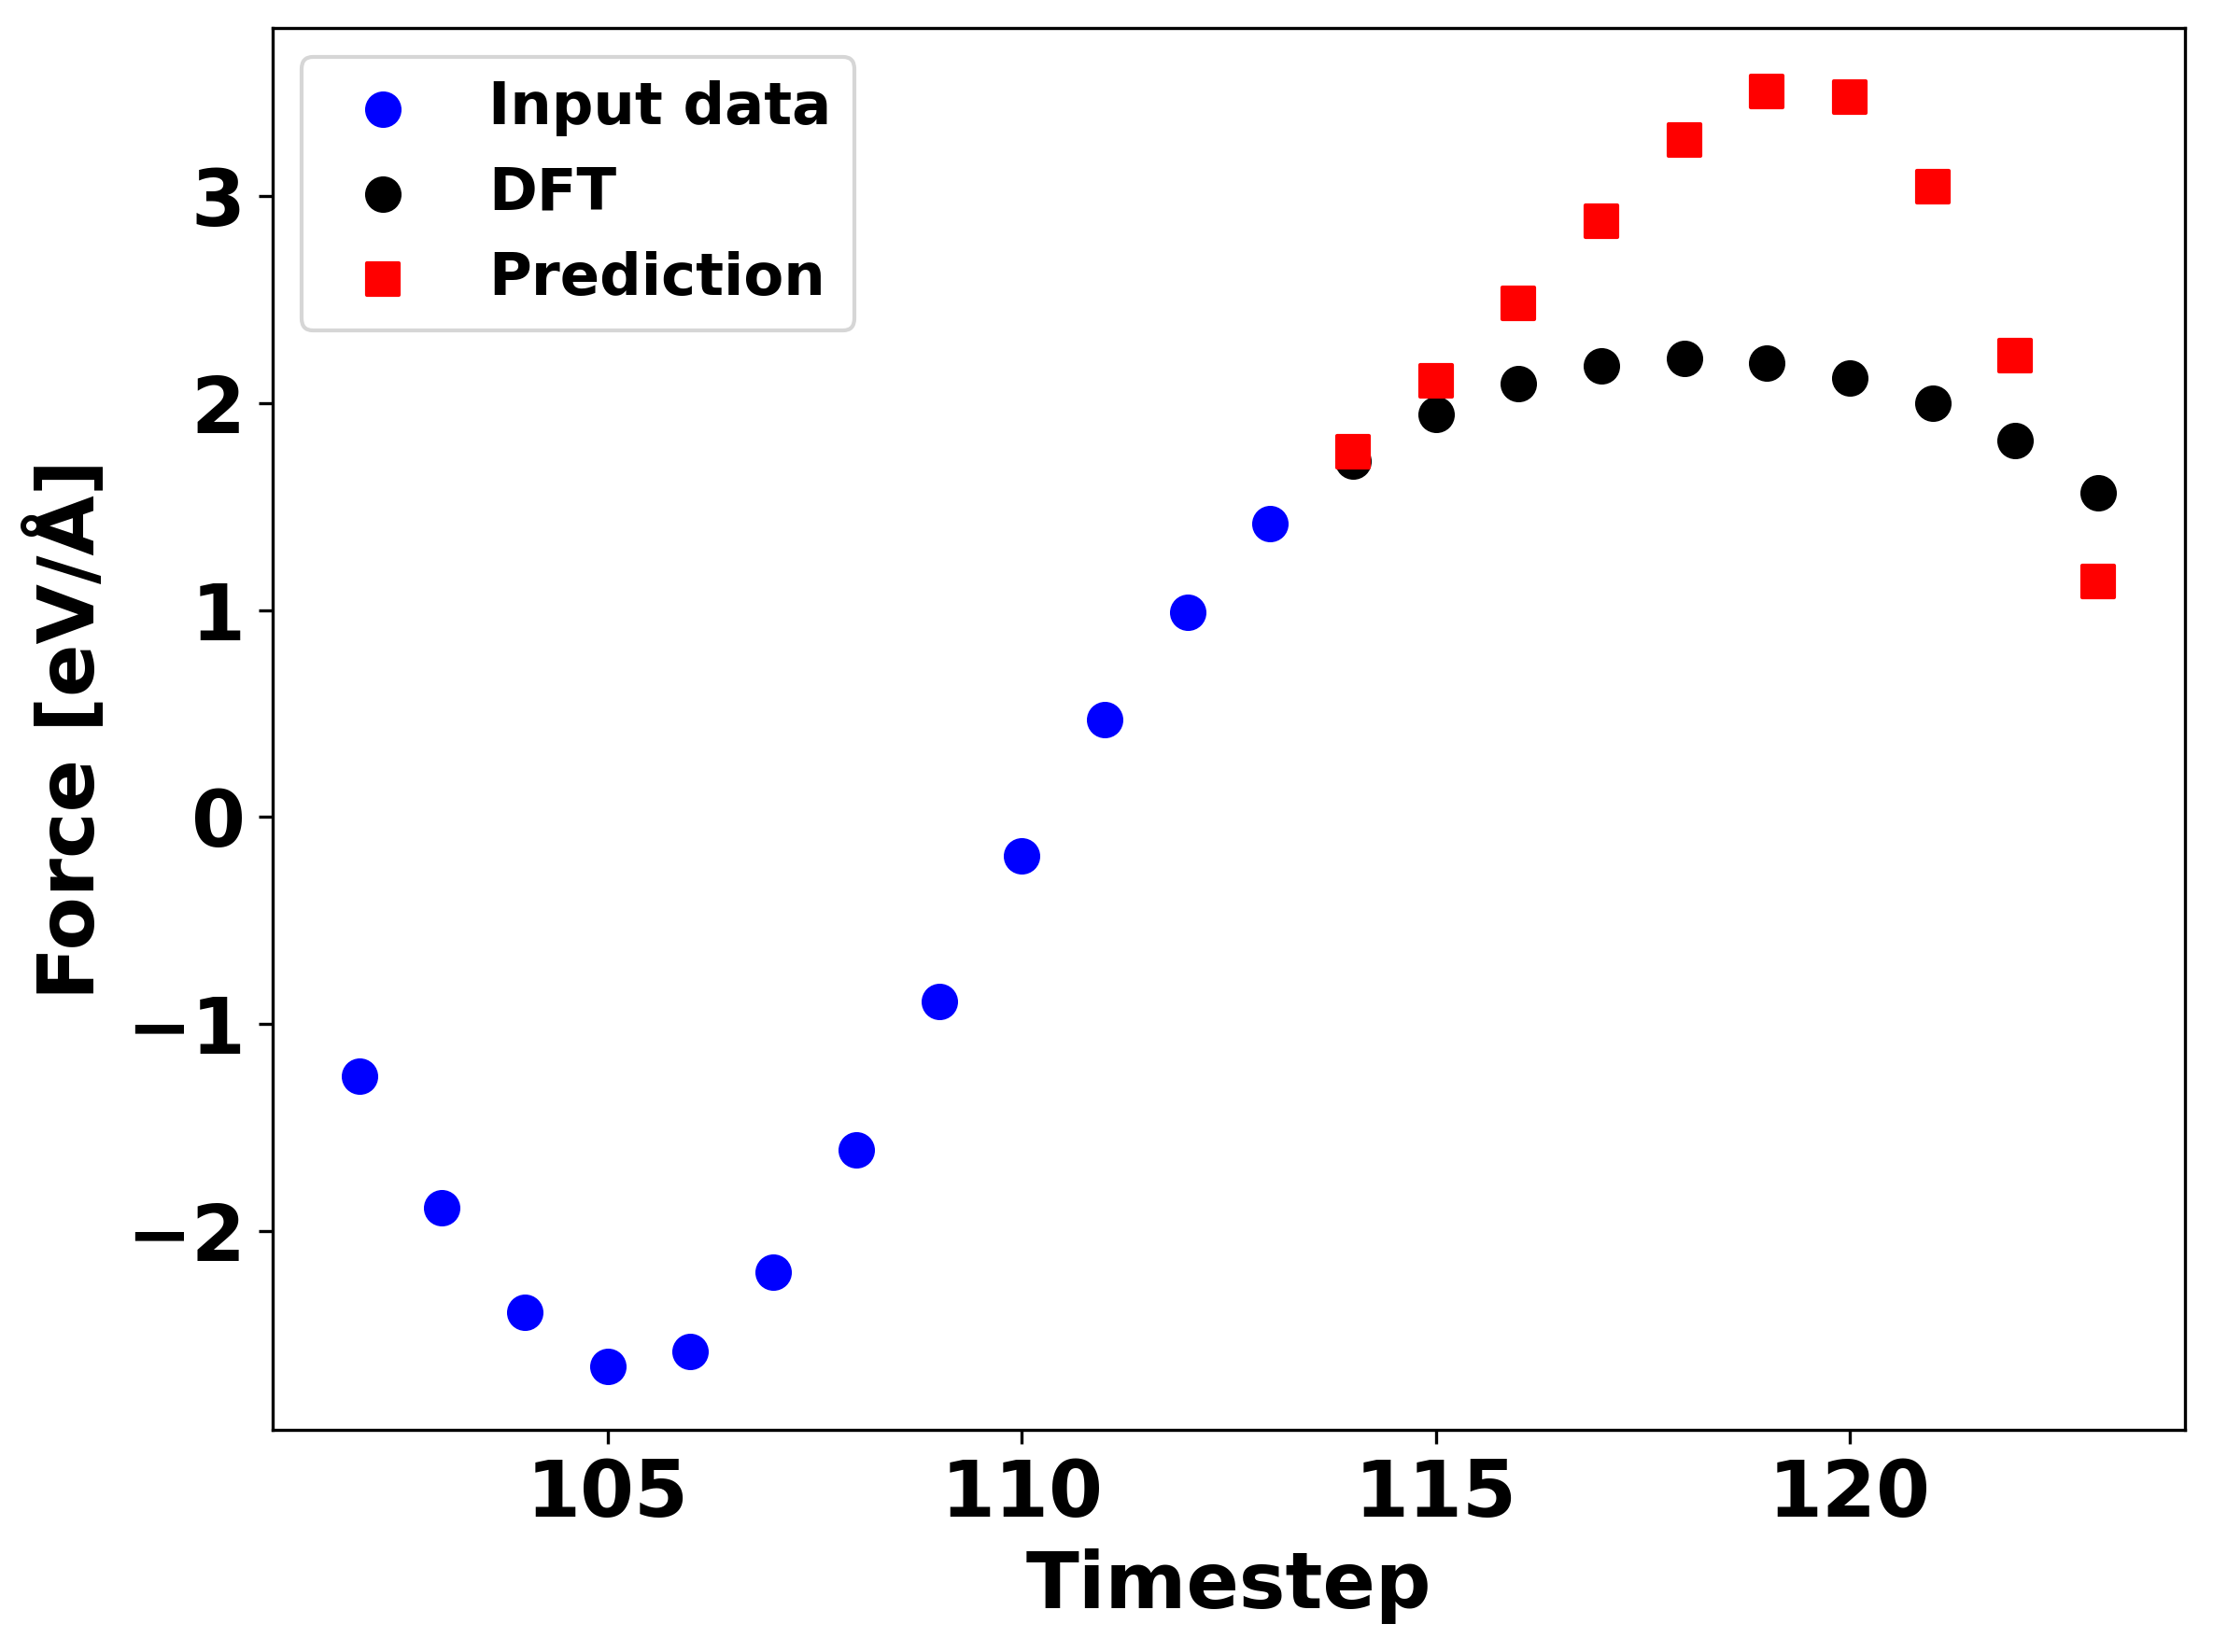
Error evaluation of model

Slide 15
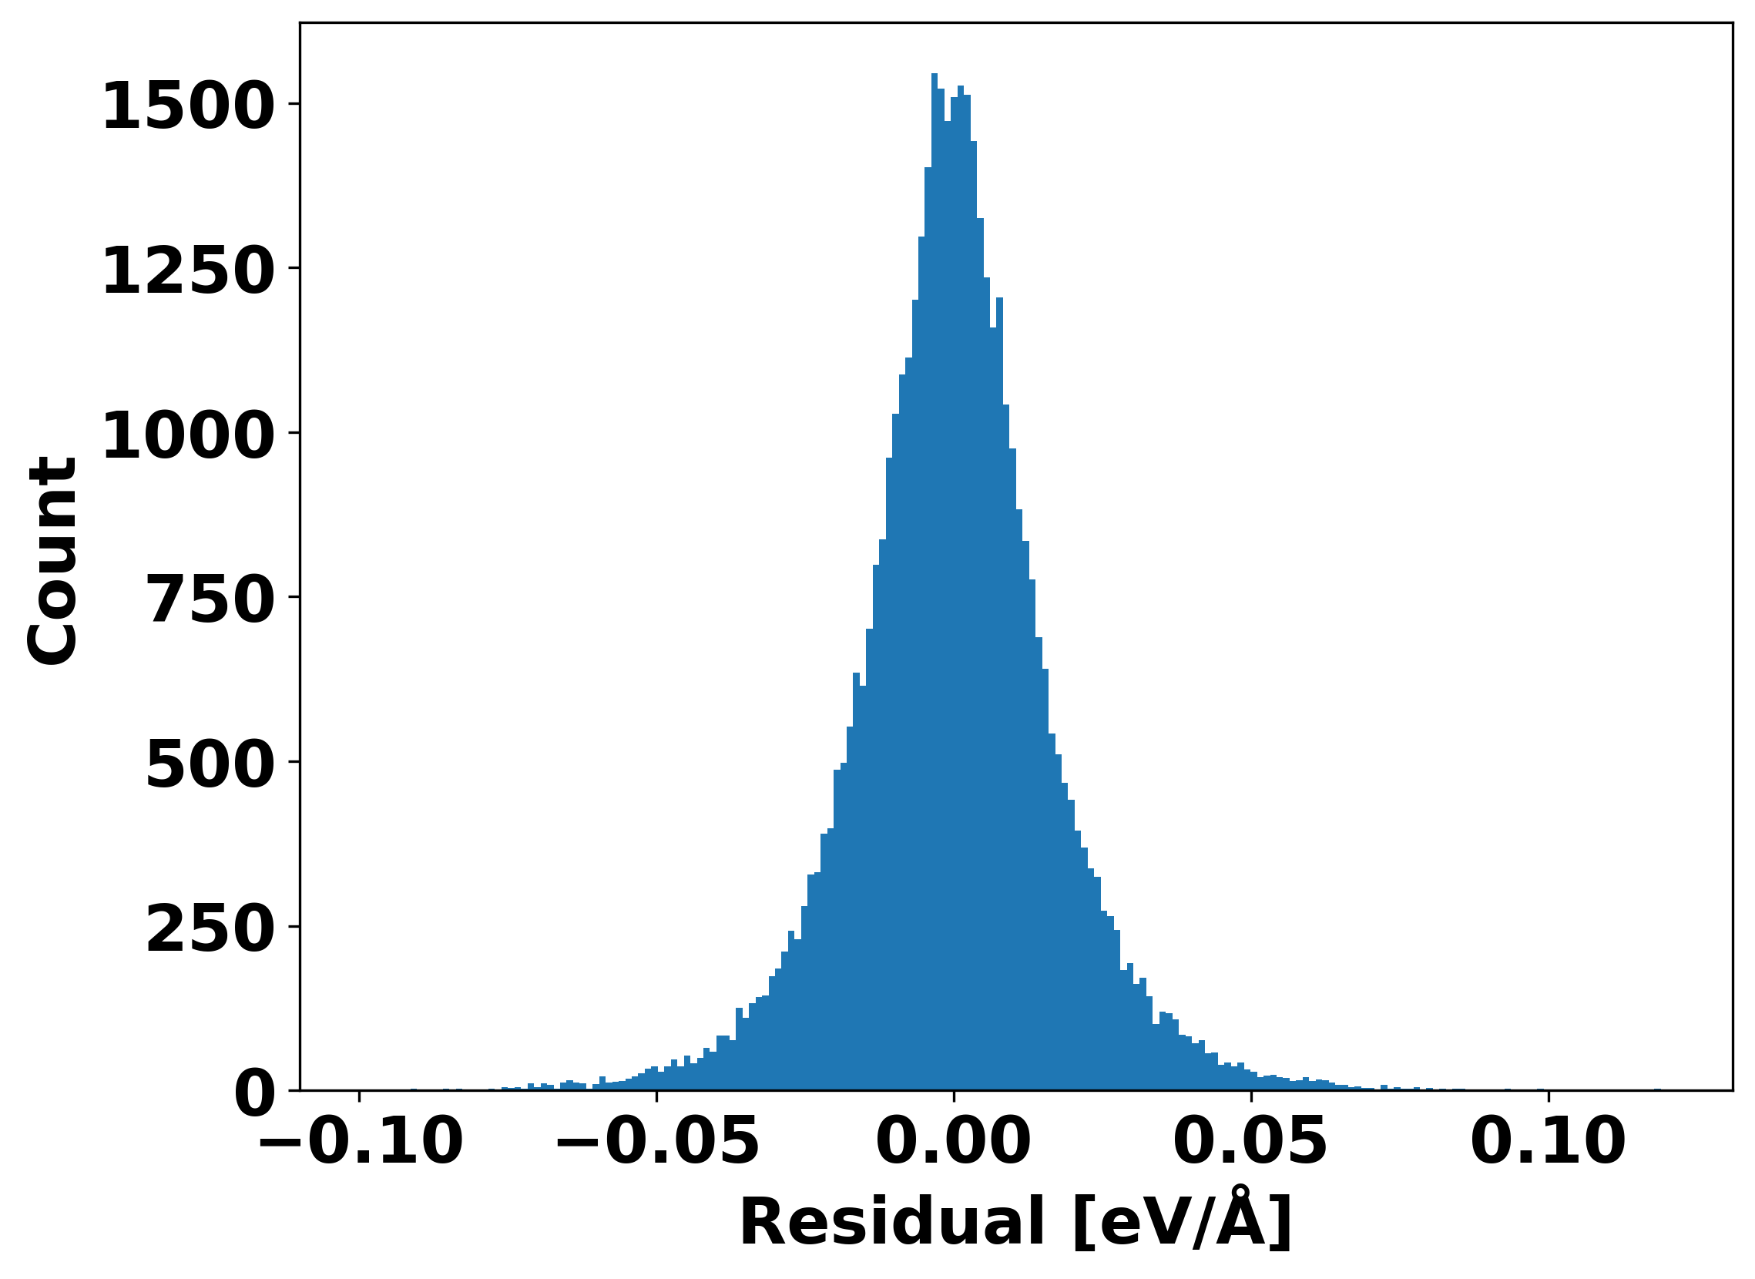
Residuals

Slide 16
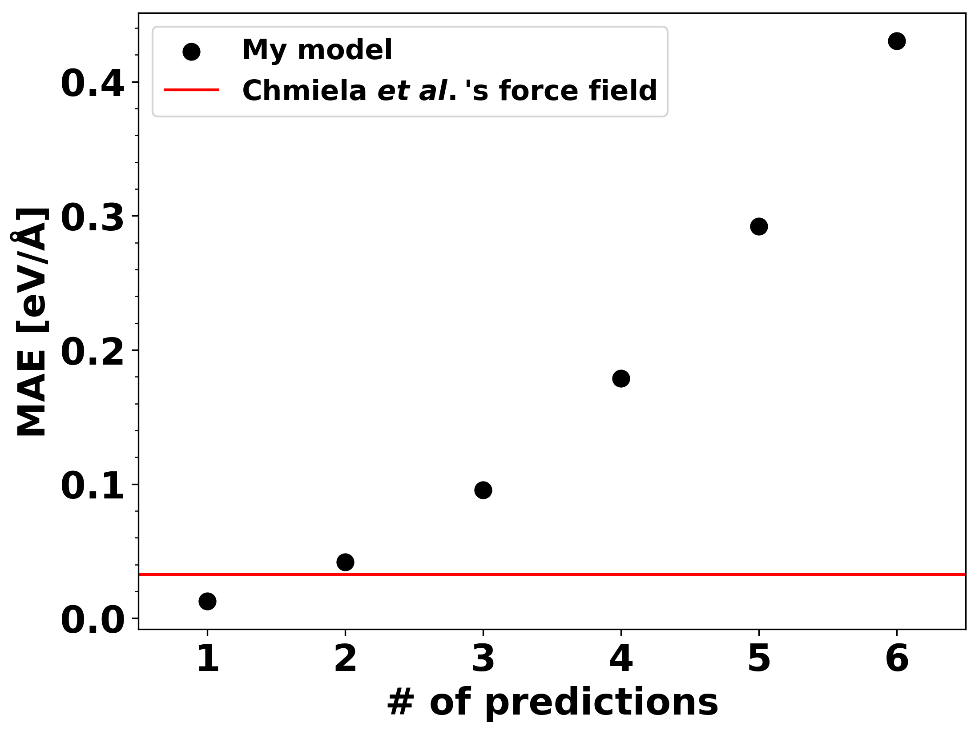
Error evaluation of model
DOI: 10.1126/sciadv.1603015

Slide 17
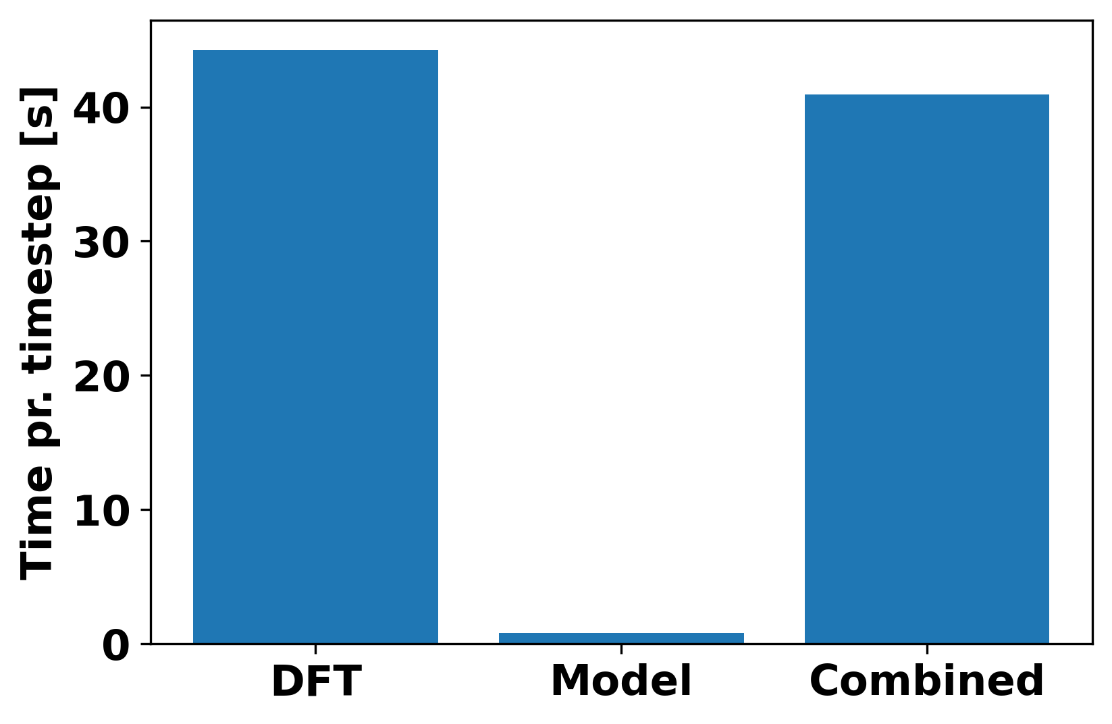
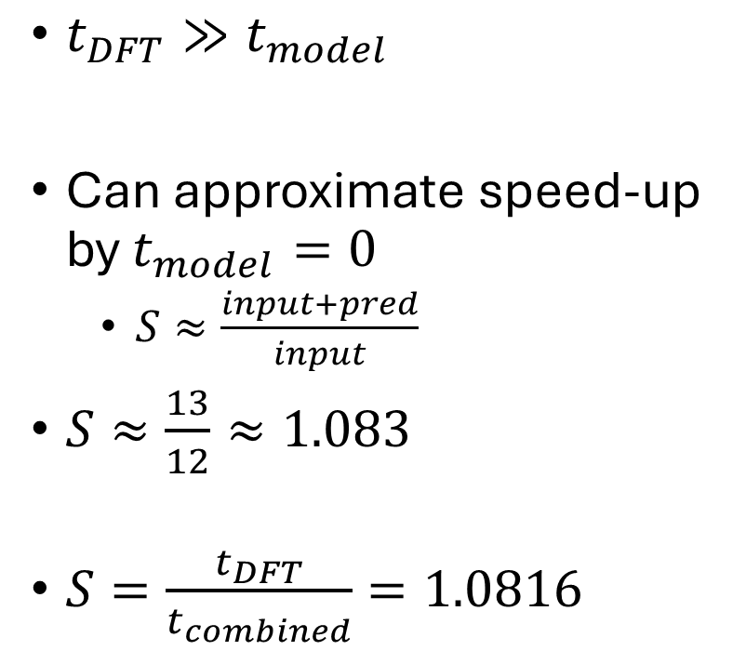
Speed-up
$t_{DFT}≫t_{model}$
Can approximate speed-up by $t_{model}=0$
$S≈\frac{input+pred}{input}$
$S≈\frac{13}{12}≈1.083$
$S=\frac{t_{DFT}}{t_{combined}}=1.0816$

Slide 18
Metrics
Chemical systems are very chaotic
Variance induced by model must be smaller than variance between different simulations
The model must introduce less error than achieving the same speed-up in a simpler way
Increasing dt used in VelVer

Slide 19
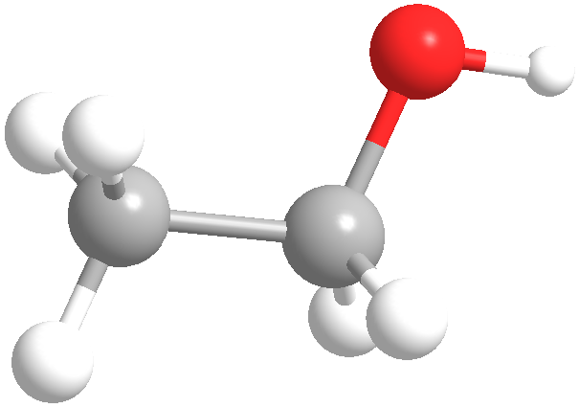
Average values

Slide 20
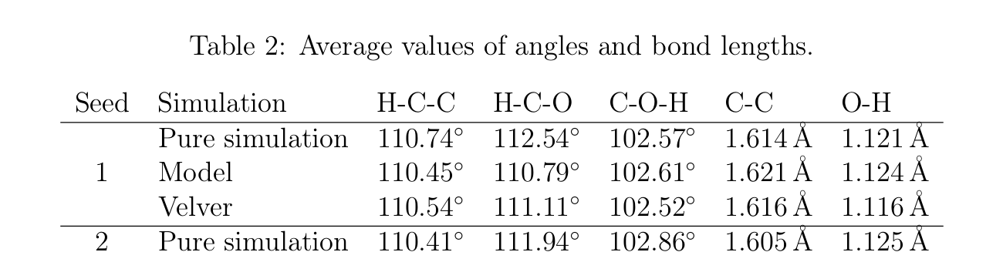
Average values

Slide 21
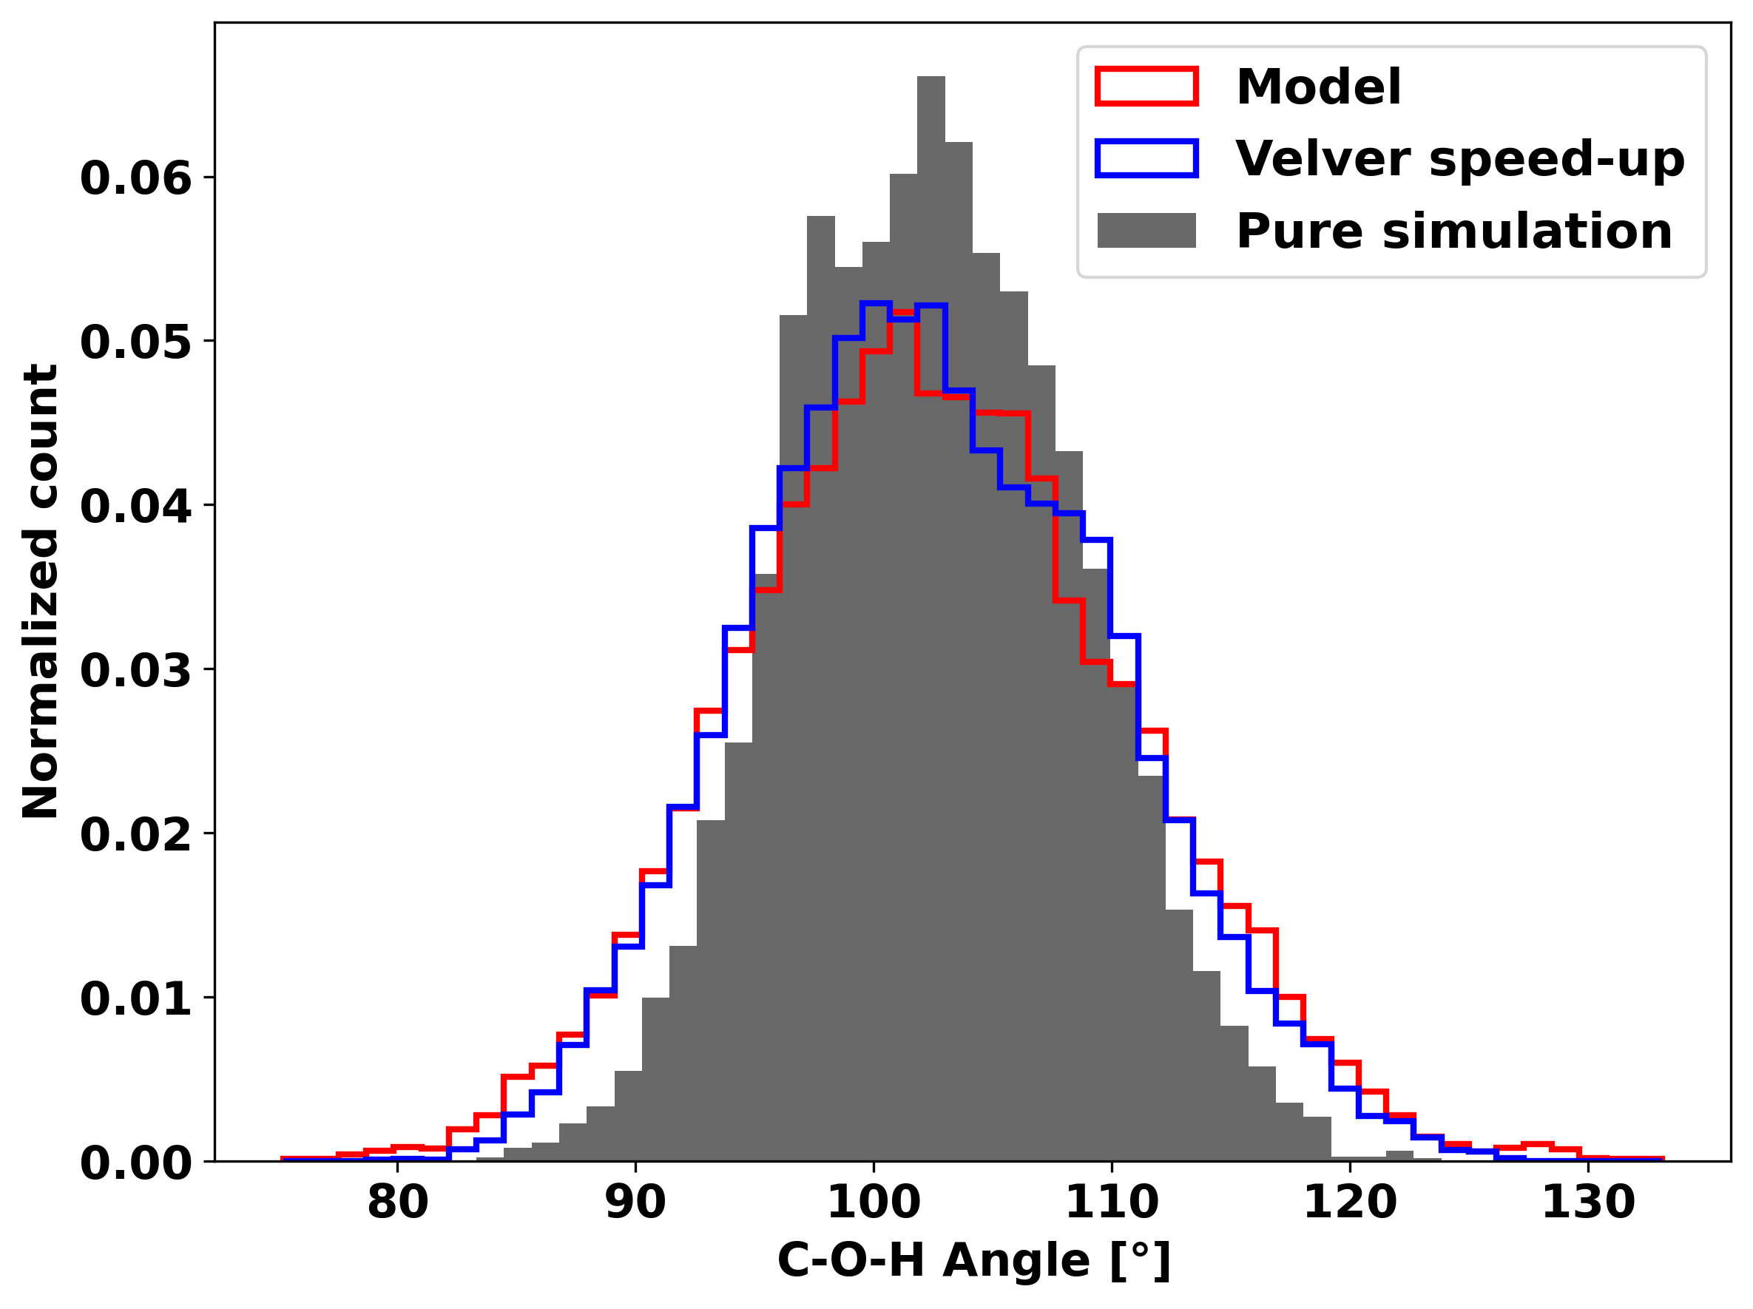
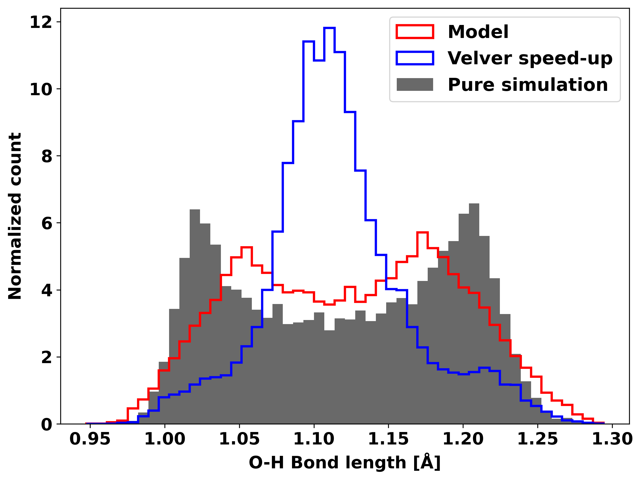
Distributions

Slide 22
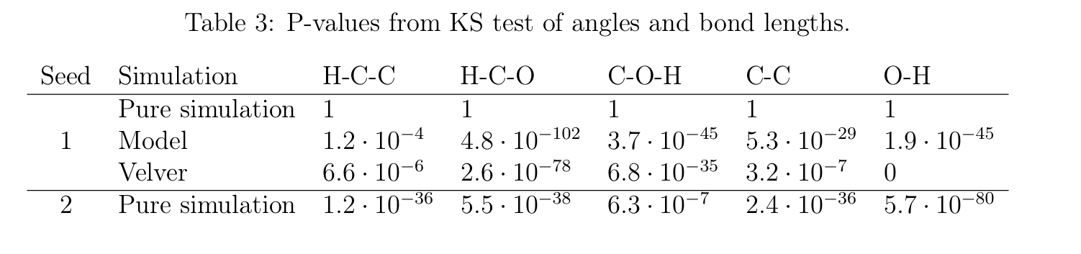
Distributions

Slide 23
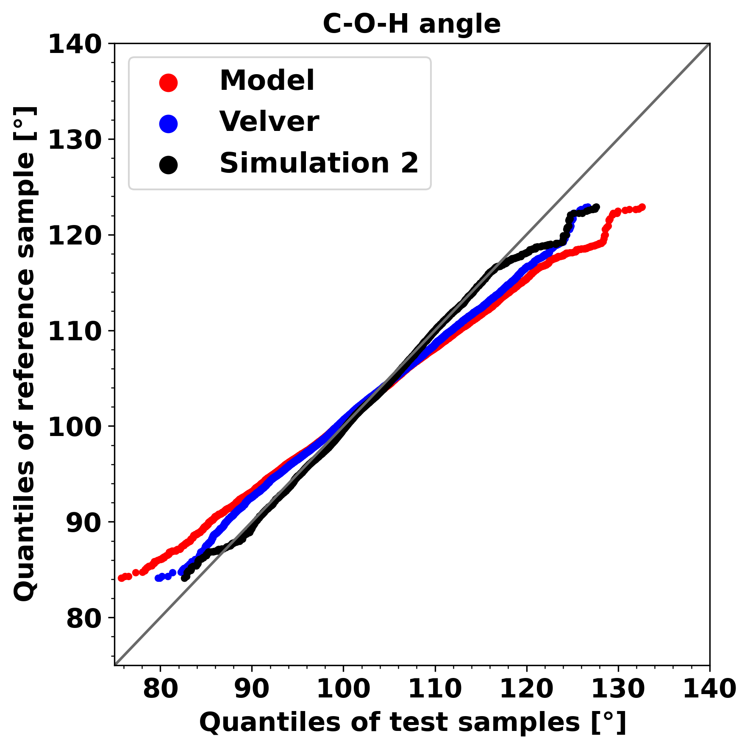
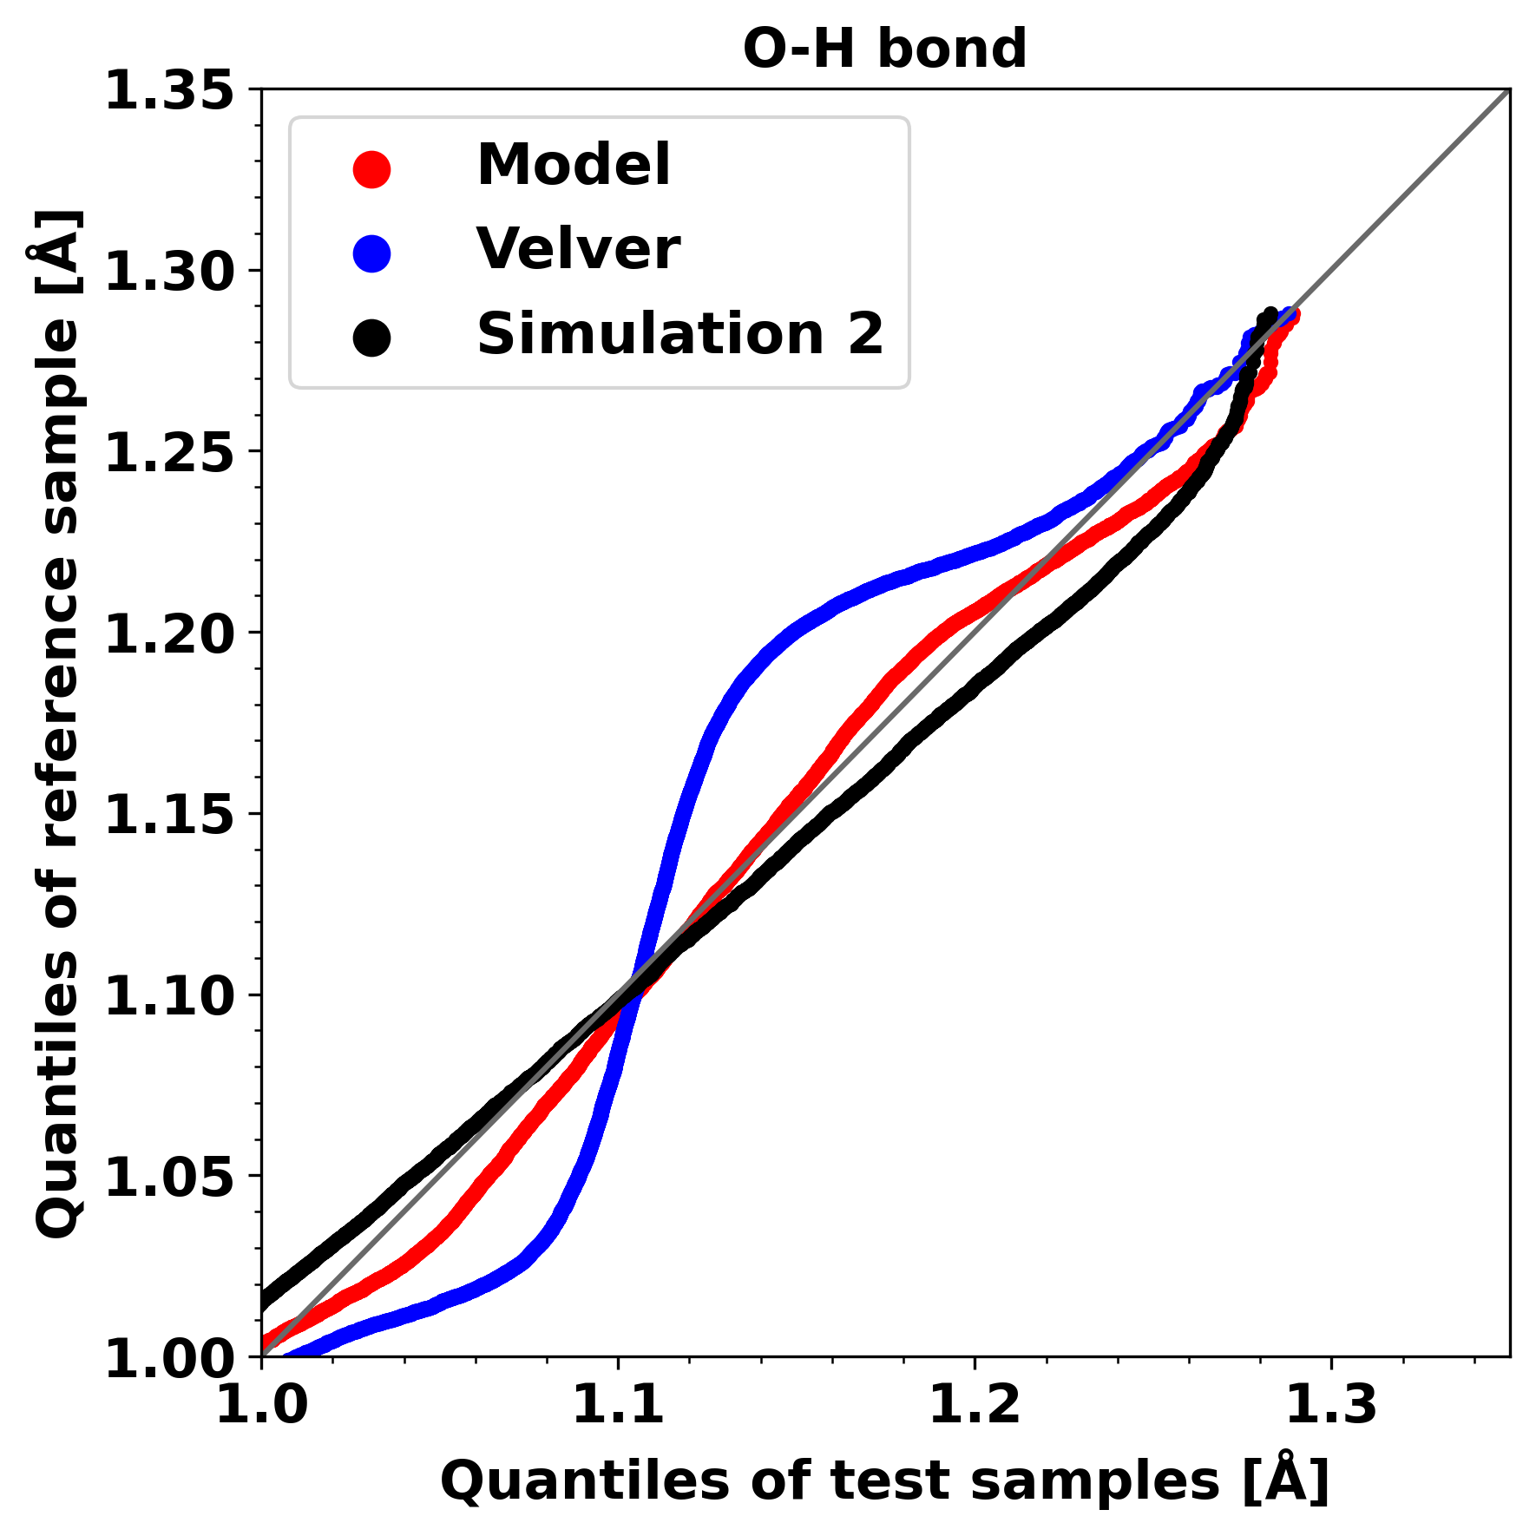
Distributions

Slide 24
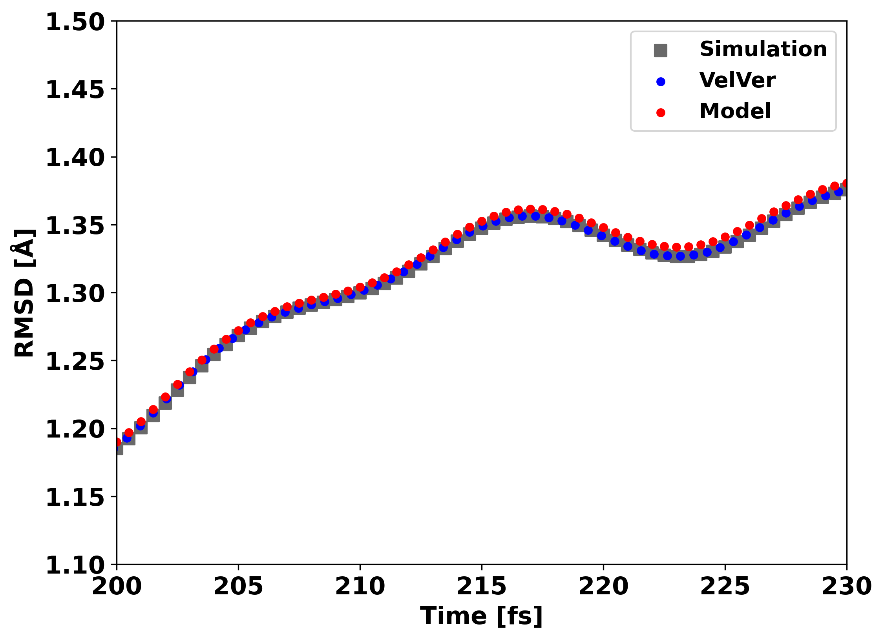
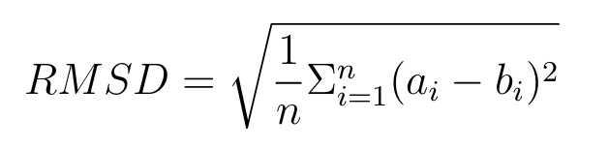
RMSD

Slide 25
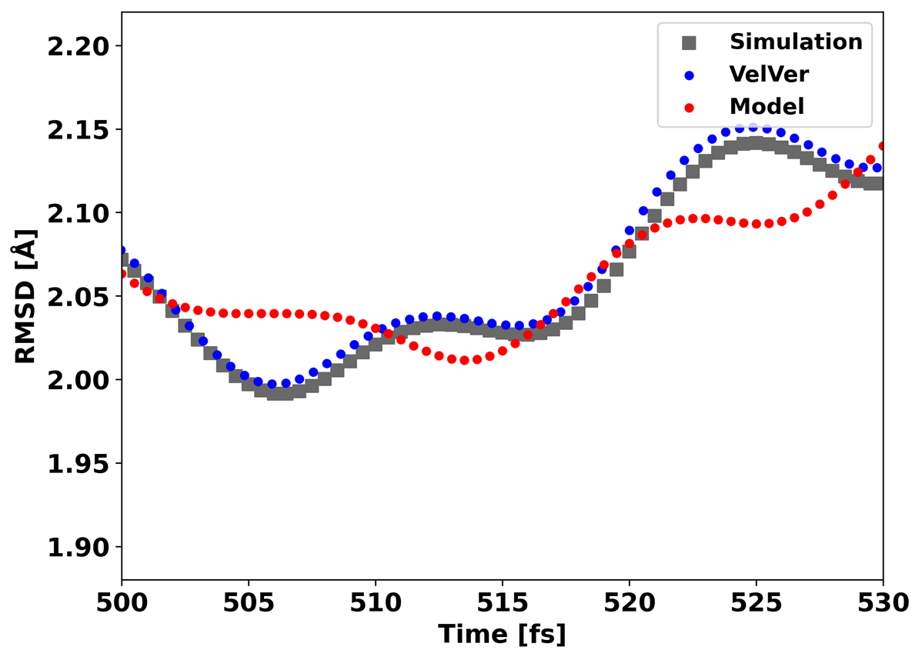
RMSD

Slide 26
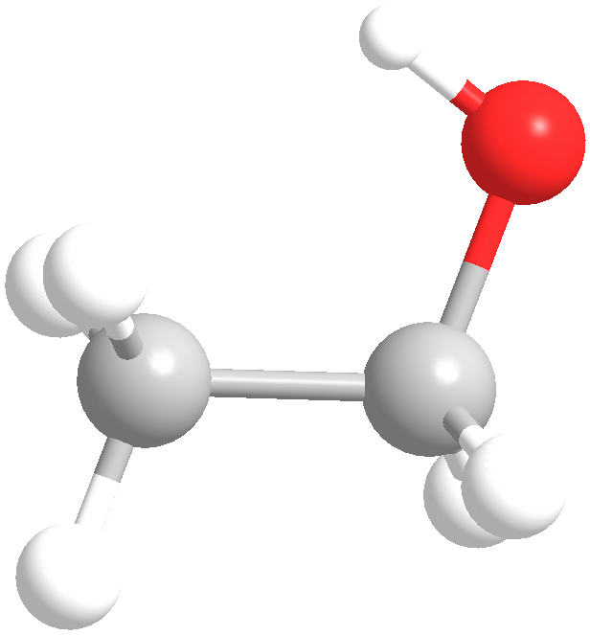
Metrics – Conformational Isomers
Anti
Gauche

Slide 27
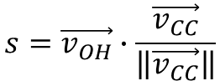
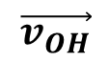
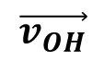
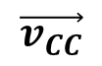
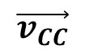
Metrics – Conformational Isomers
$$\vec{v_{OH}}$$
$$\vec{v_{OH}}$$
$$\vec{v_{CC}}$$
$$\vec{v_{CC}}$$
Anti
$$s=\vec{v_{OH}}∙\frac{\vec{v_{CC}}}{\left\|\vec{v_{CC}}\right\|}$$
Gauche

Slide 28
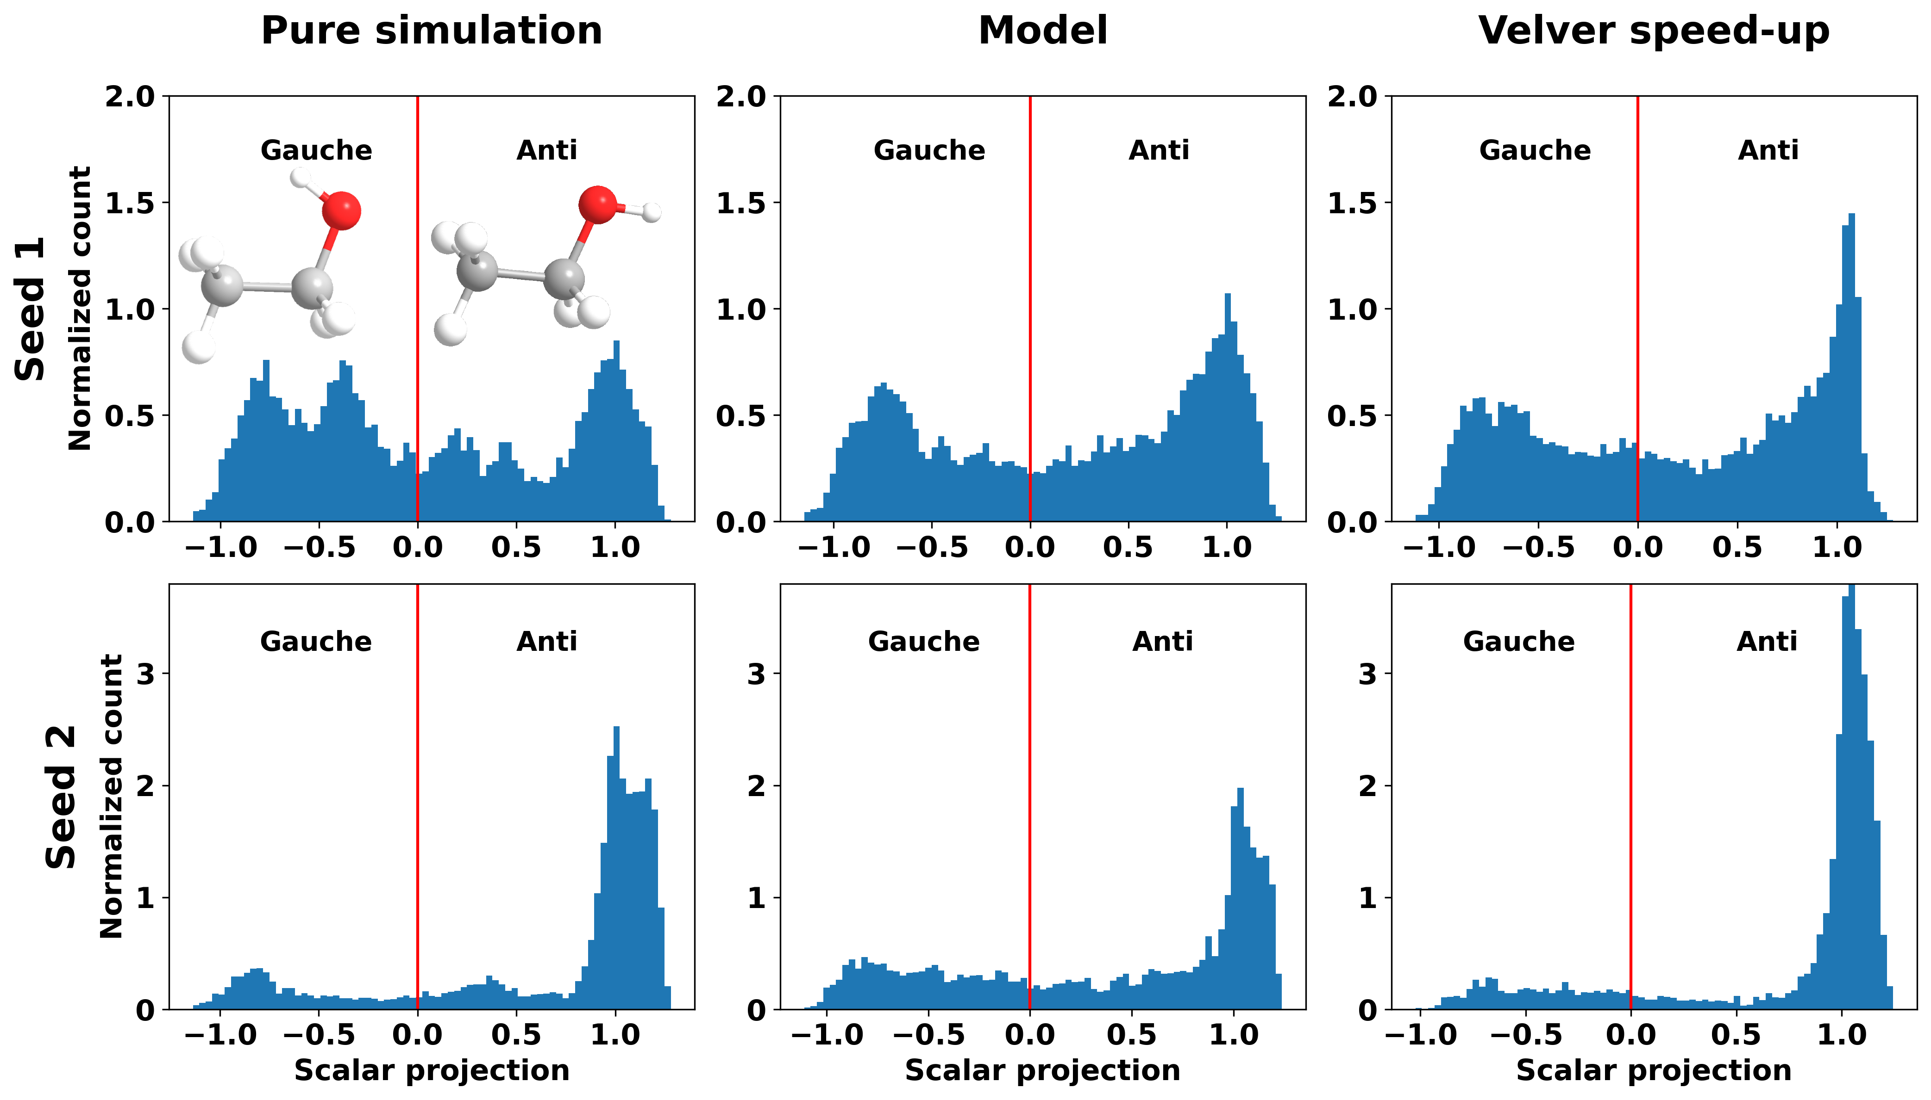
Conformational Isomers

Slide 29
Metrics – 2D Dihedral Angles

Slide 30
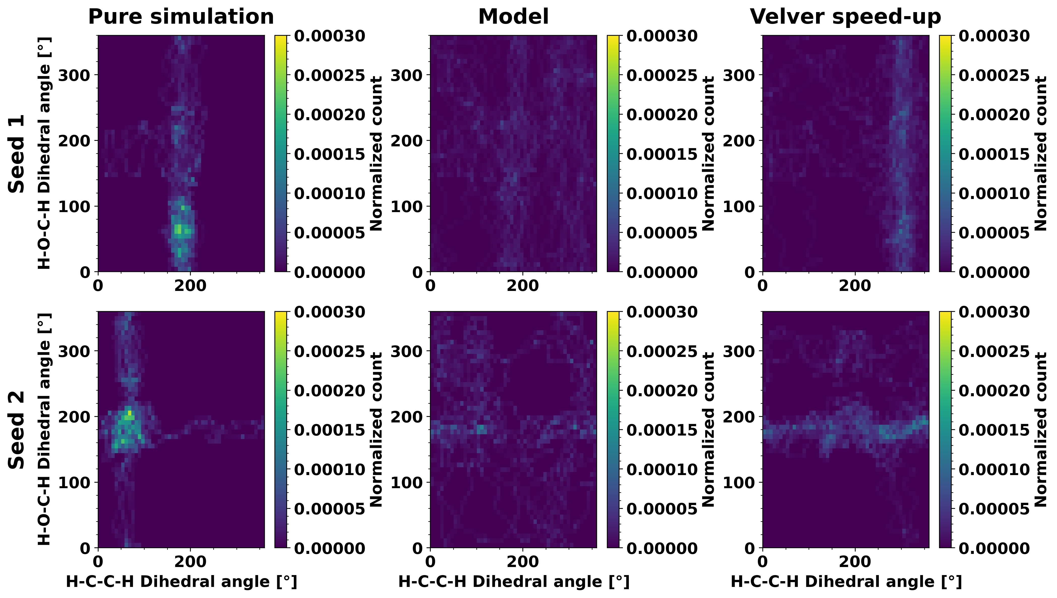
Dihedral angles
Notes:
Der skal gøres noget ved x-aksen så det er det samme på tværs af plots

Slide 31
Evaluating Model
Performance depends on metrics evaluated
The model does not perform well enough on ethanol
Improving model requires increasing the speed-up or reducing the error

Slide 32
Large Molecules
4
3
Count
2
1
-4
-3
-2
-1
0
1
2
3
4
Error [a. u.]

Slide 33
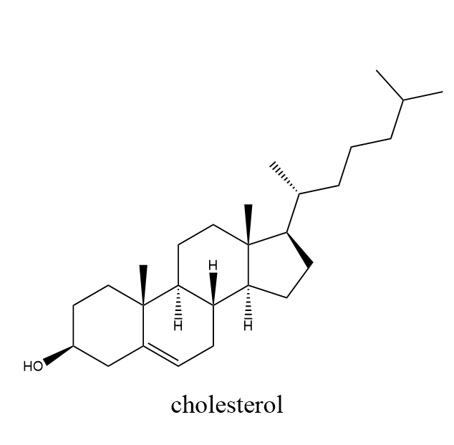
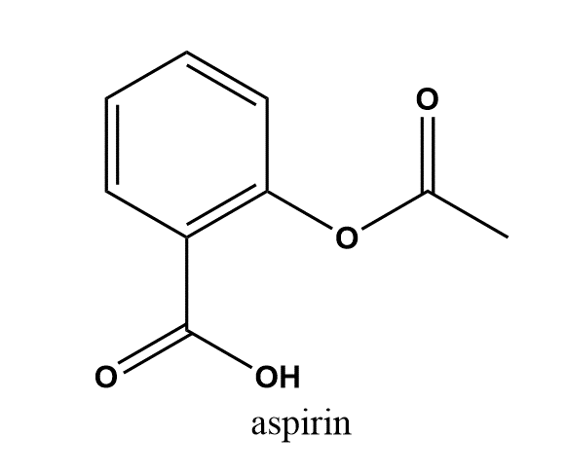
Large Molecules

Slide 34
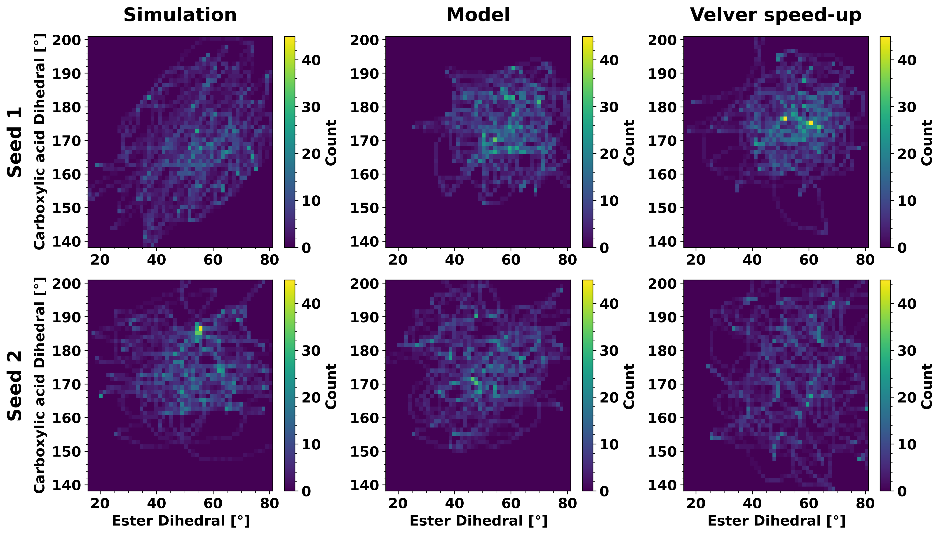
Large Molecules – Aspirin

Slide 35
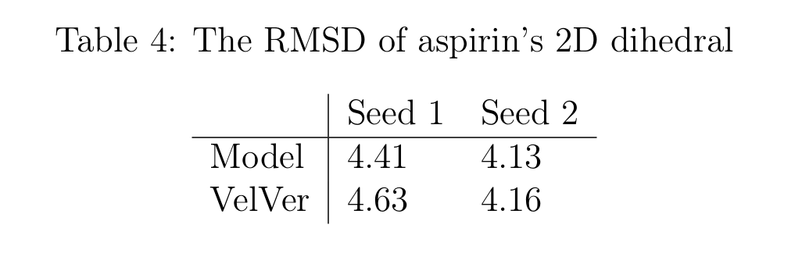
Large Molecules– Aspirin

Slide 36
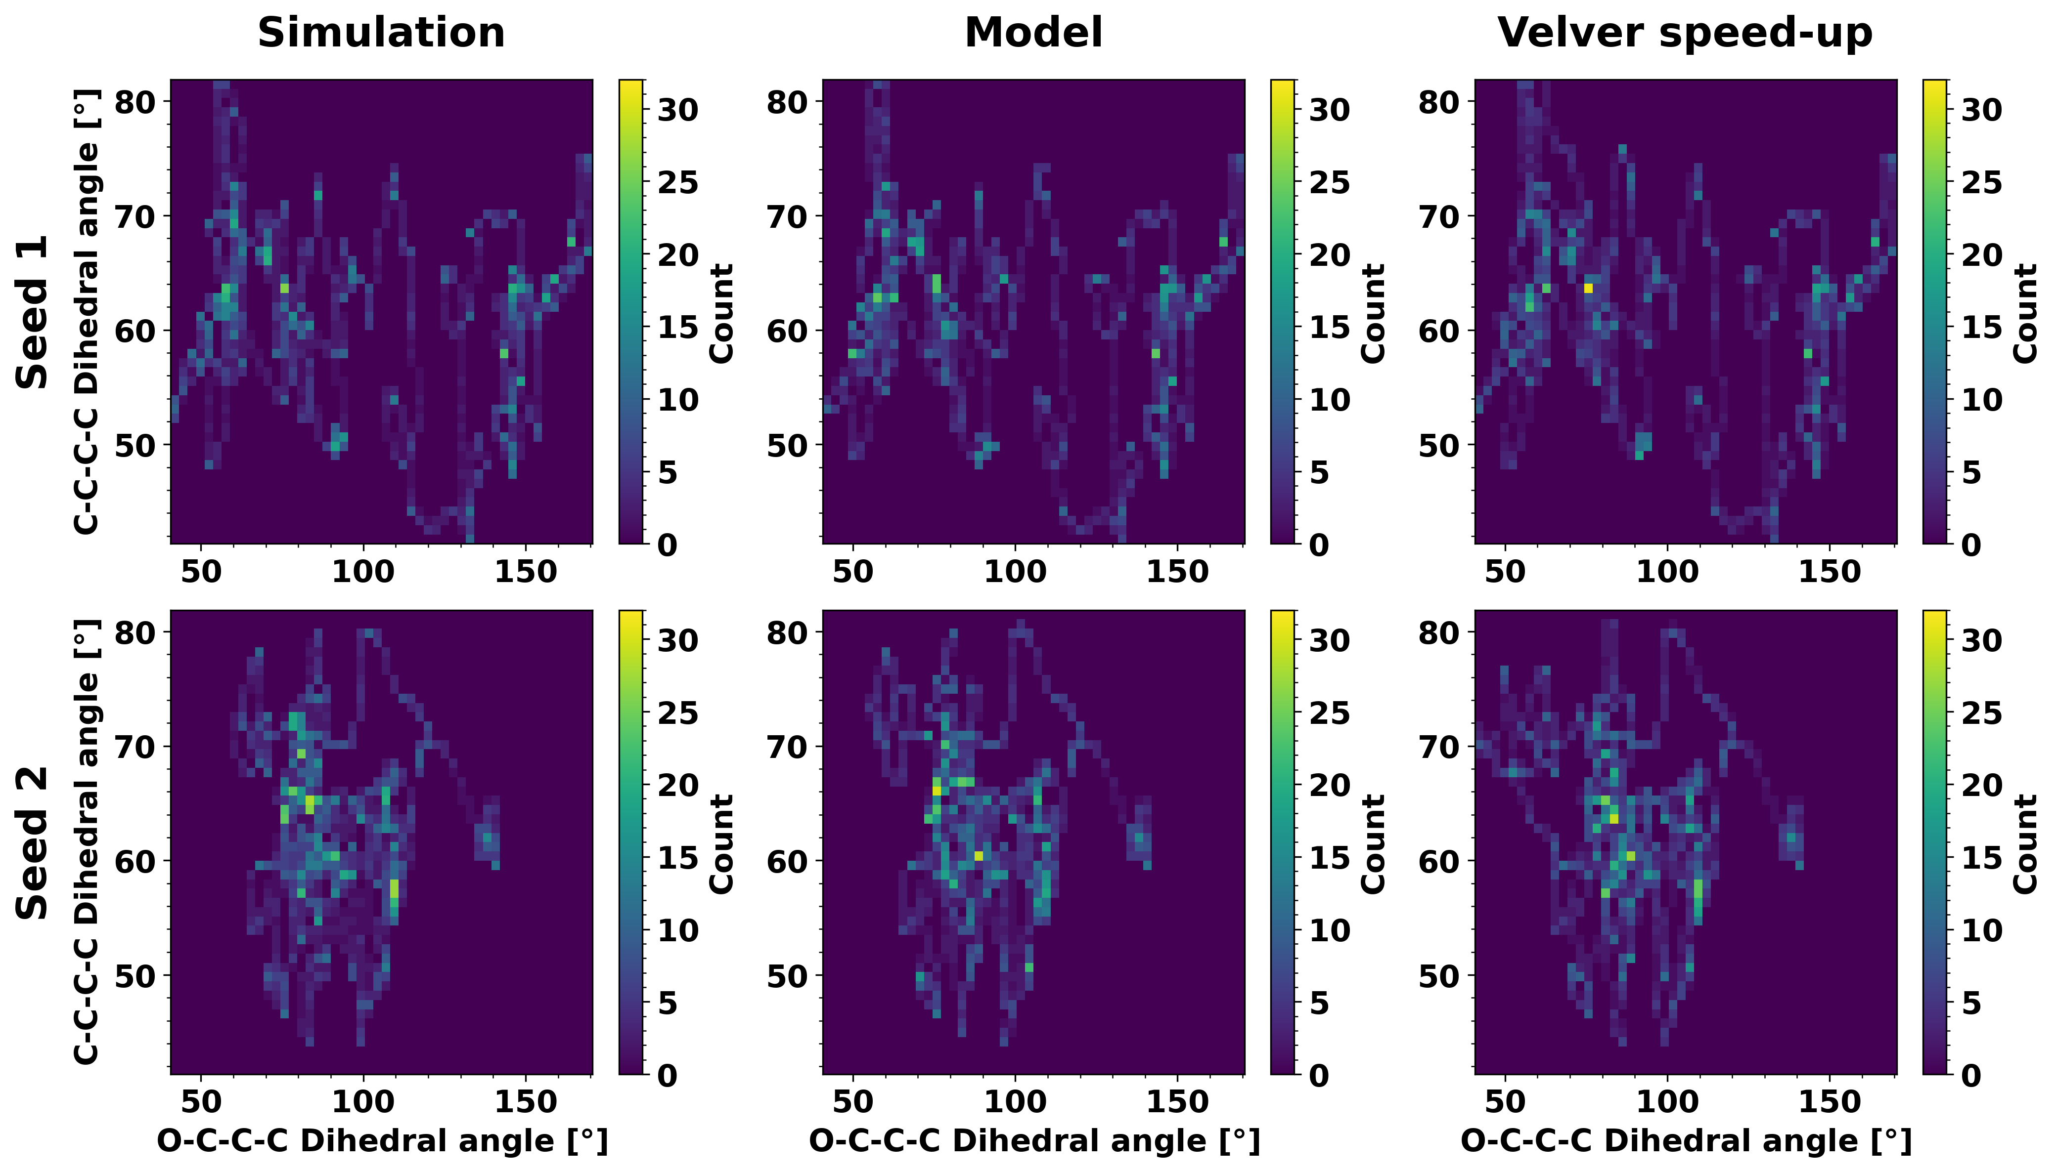
Large Molecules– Cholesterol

Slide 37
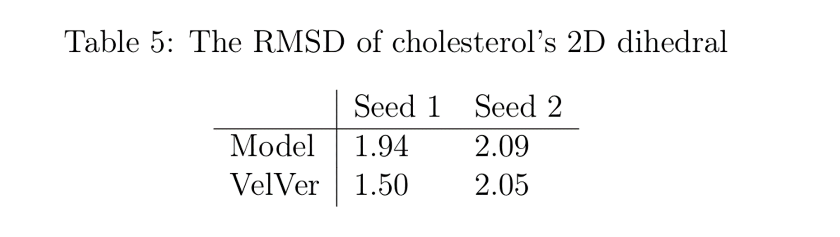
Large Molecules– Cholesterol

Slide 38
Large Molecules - Summary
Performs much better than ethanol
Model performs slightly better on aspirin than increasing dt
More research needed before model is applied
Low sample size
Finding good system

Slide 39
RNN
Predicted forces
RNN
Atomic numbers
Forces
Descriptor

Slide 40
RNN – Traj Model
Validation data
Training data
Test data
Trajectory
~15000 time steps

Slide 41
RNN – Window Model

Slide 42
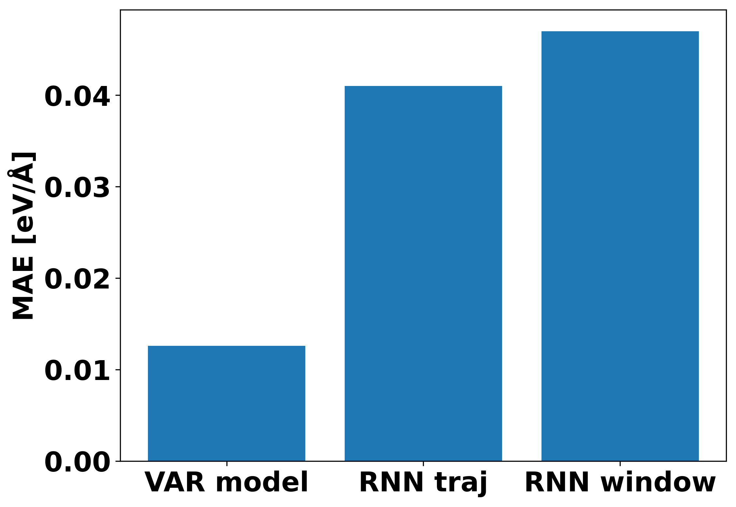
RNN – Results

Slide 43
Conclusion
Should be wary of the metrics used
My model performs badly on ethanol
Fails both criteria
Model performs better on large molecules
Slightly better than increasing dt on some systems
Was not able to create RNN with lower MAE than VAR

Slide 44
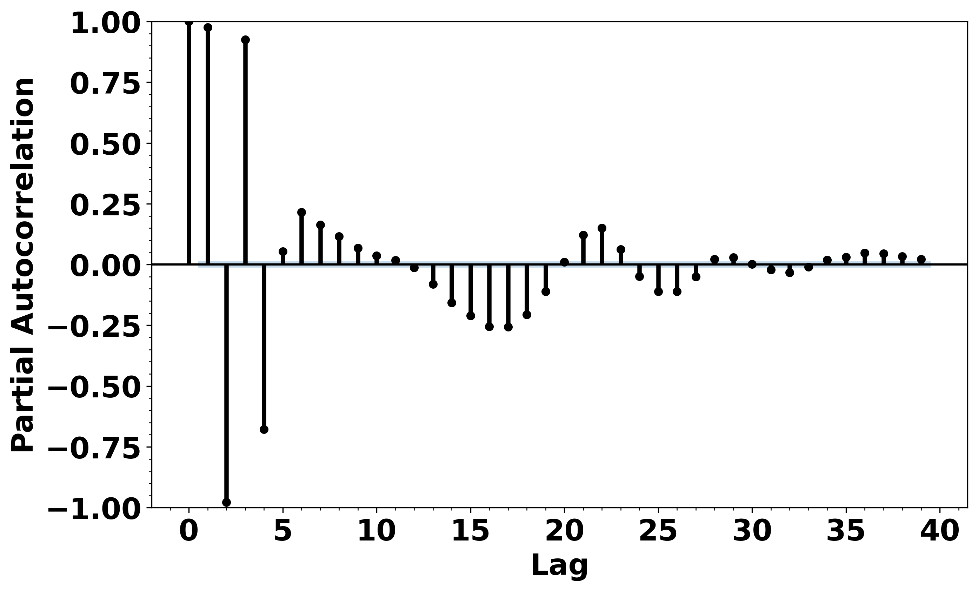
Appendix

Slide 45
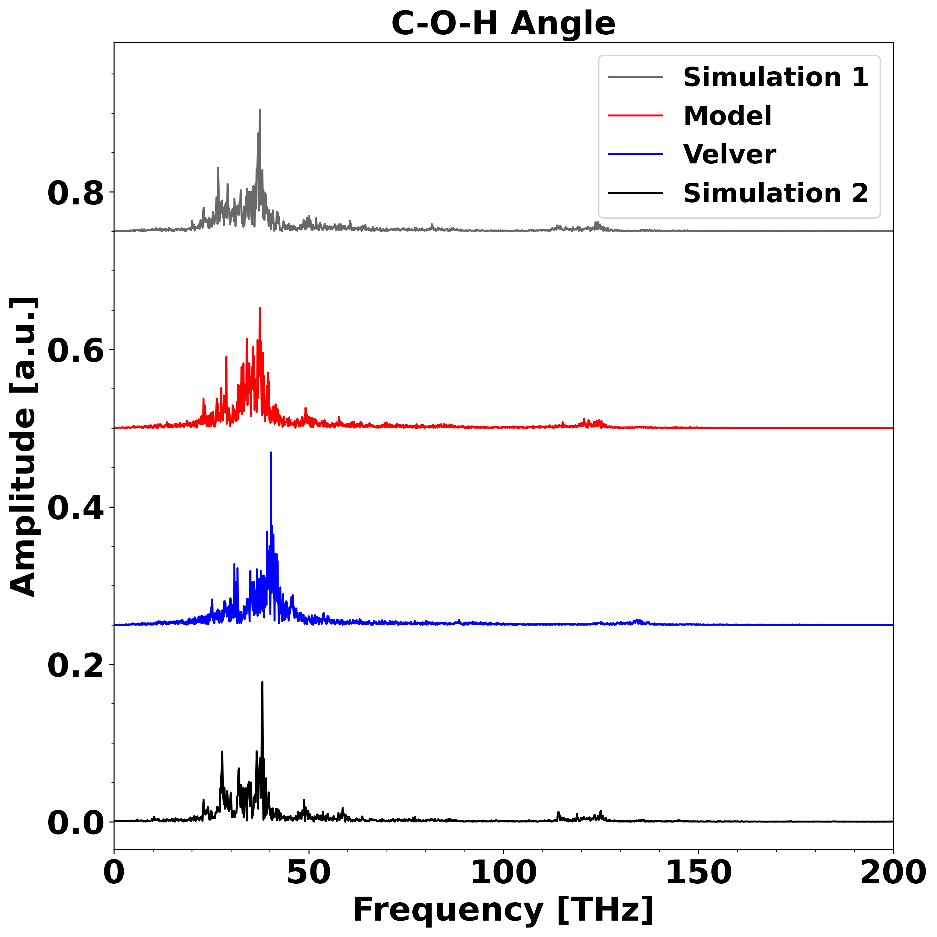
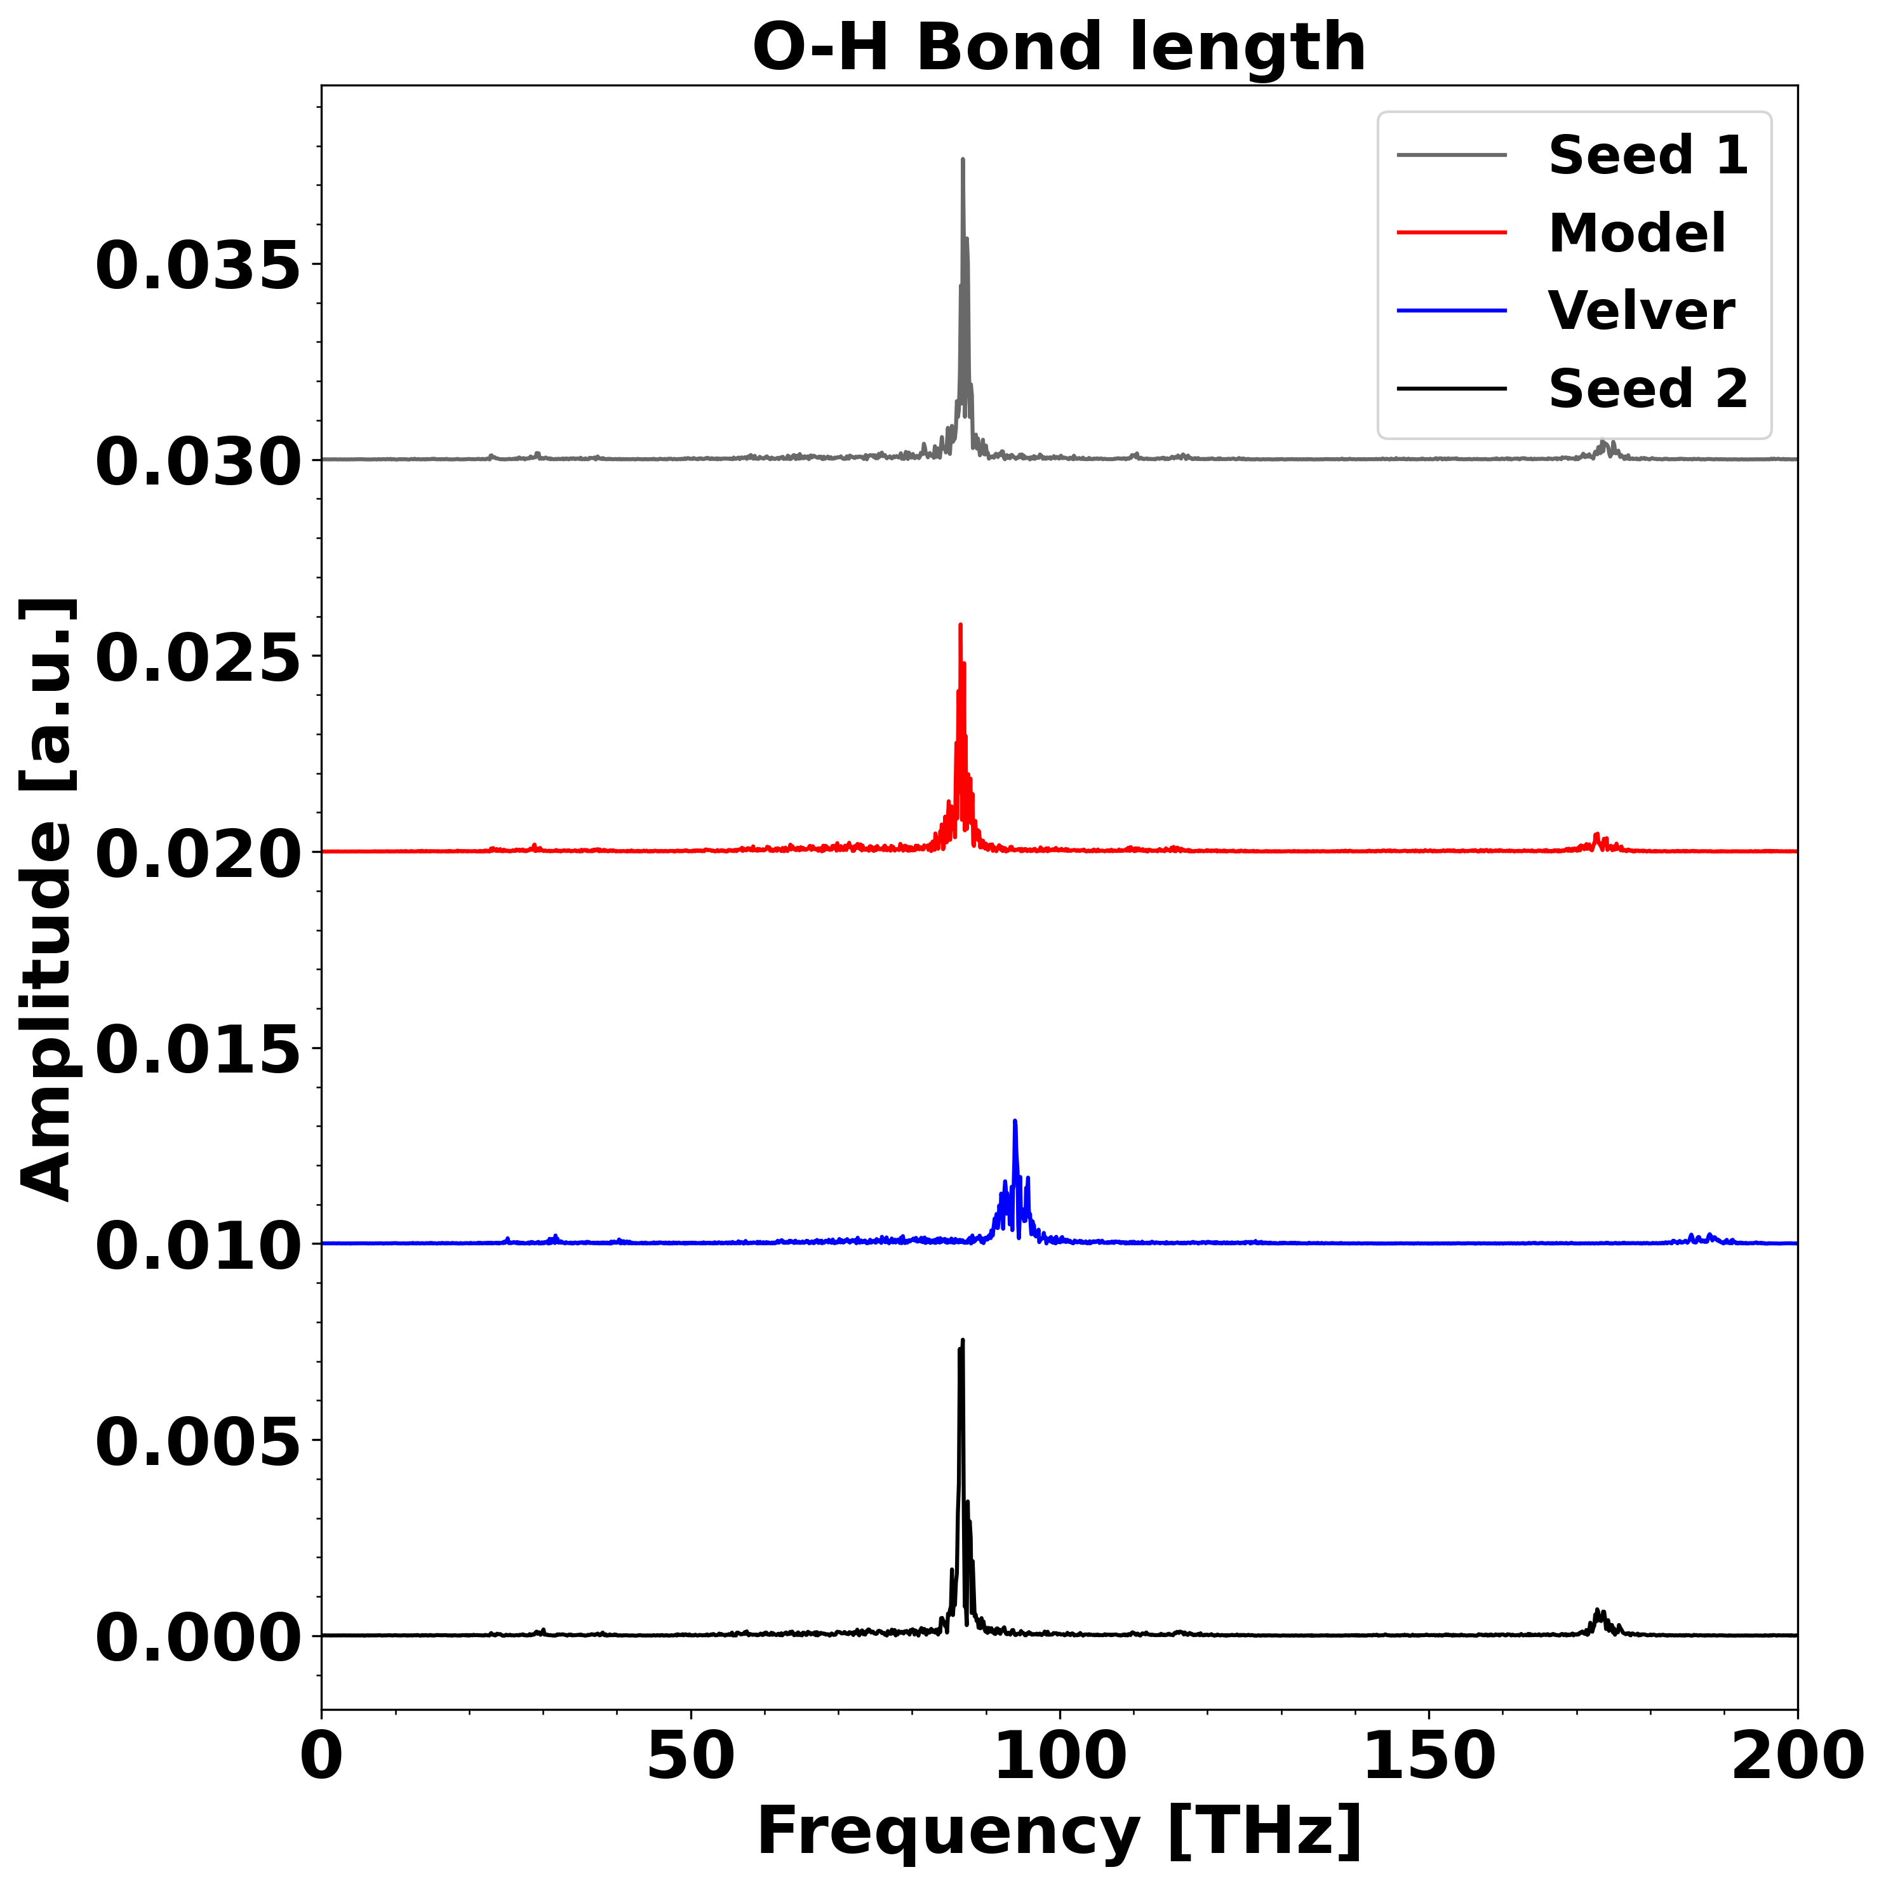
Appendix

Slide 46
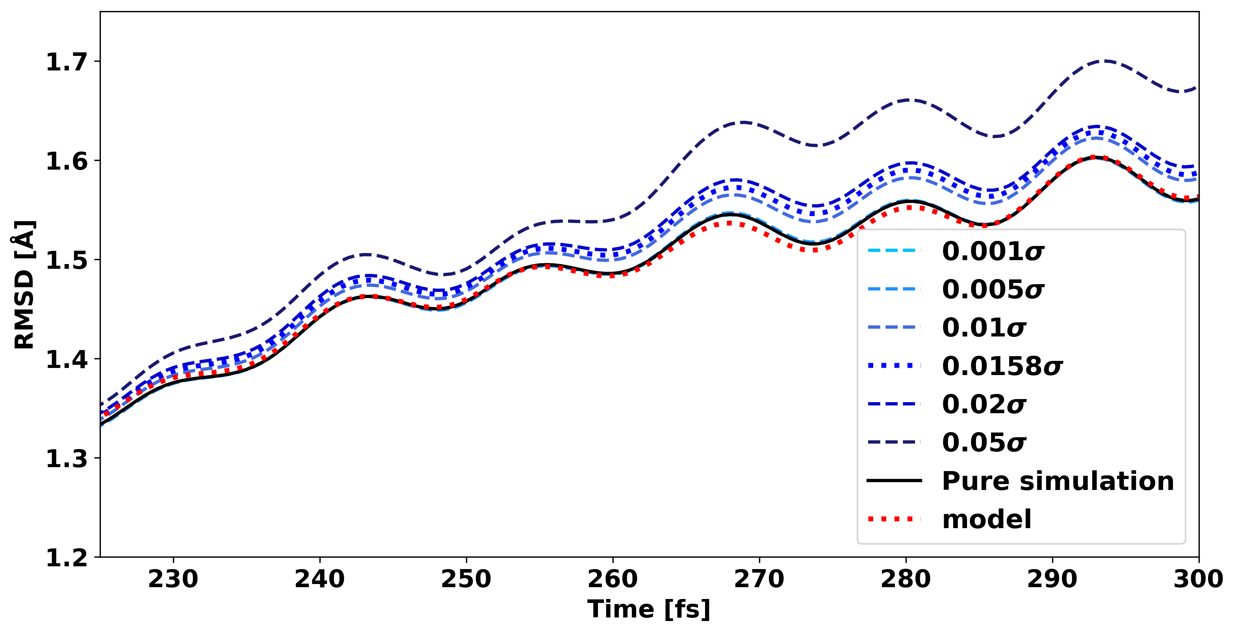
Appendix

Slide 47
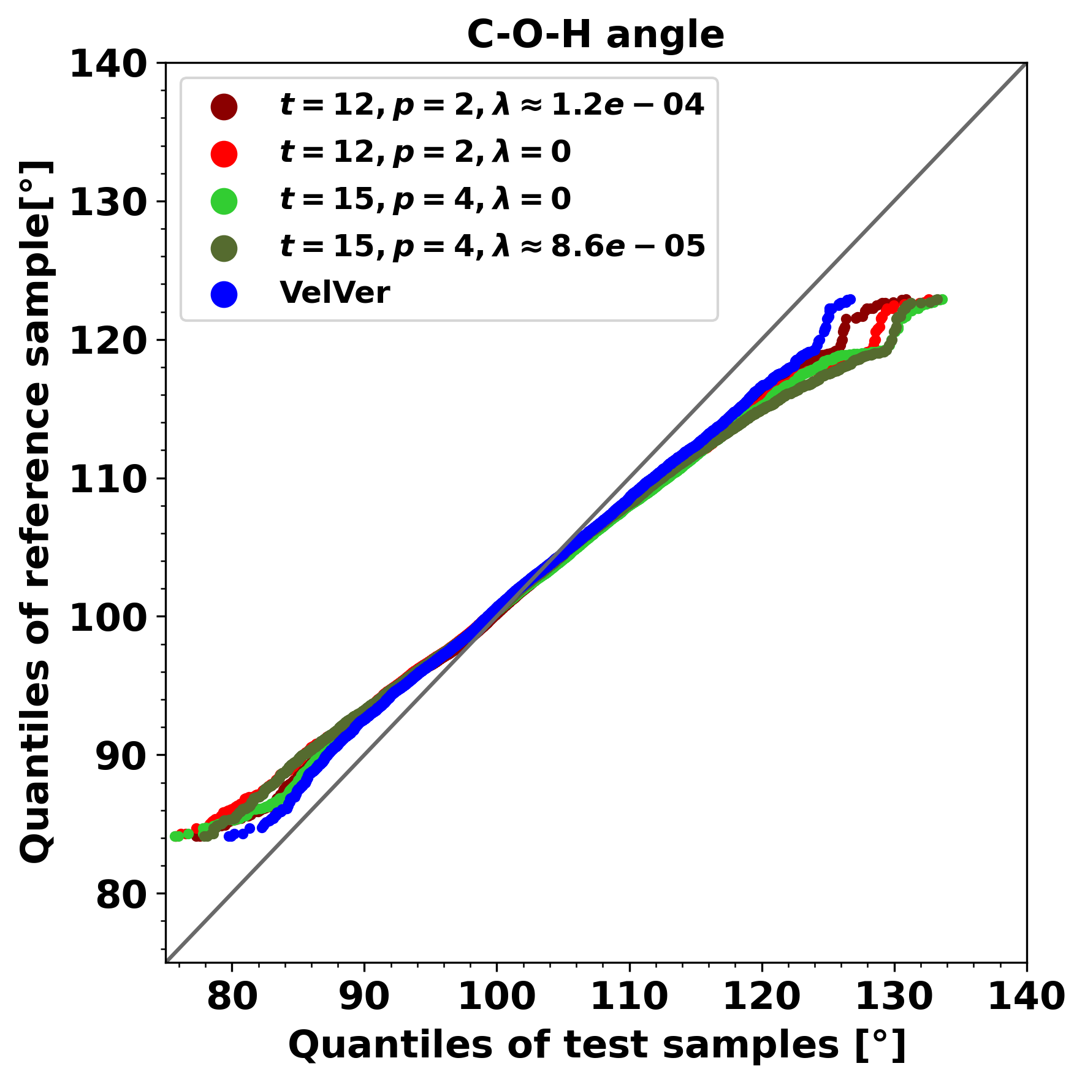
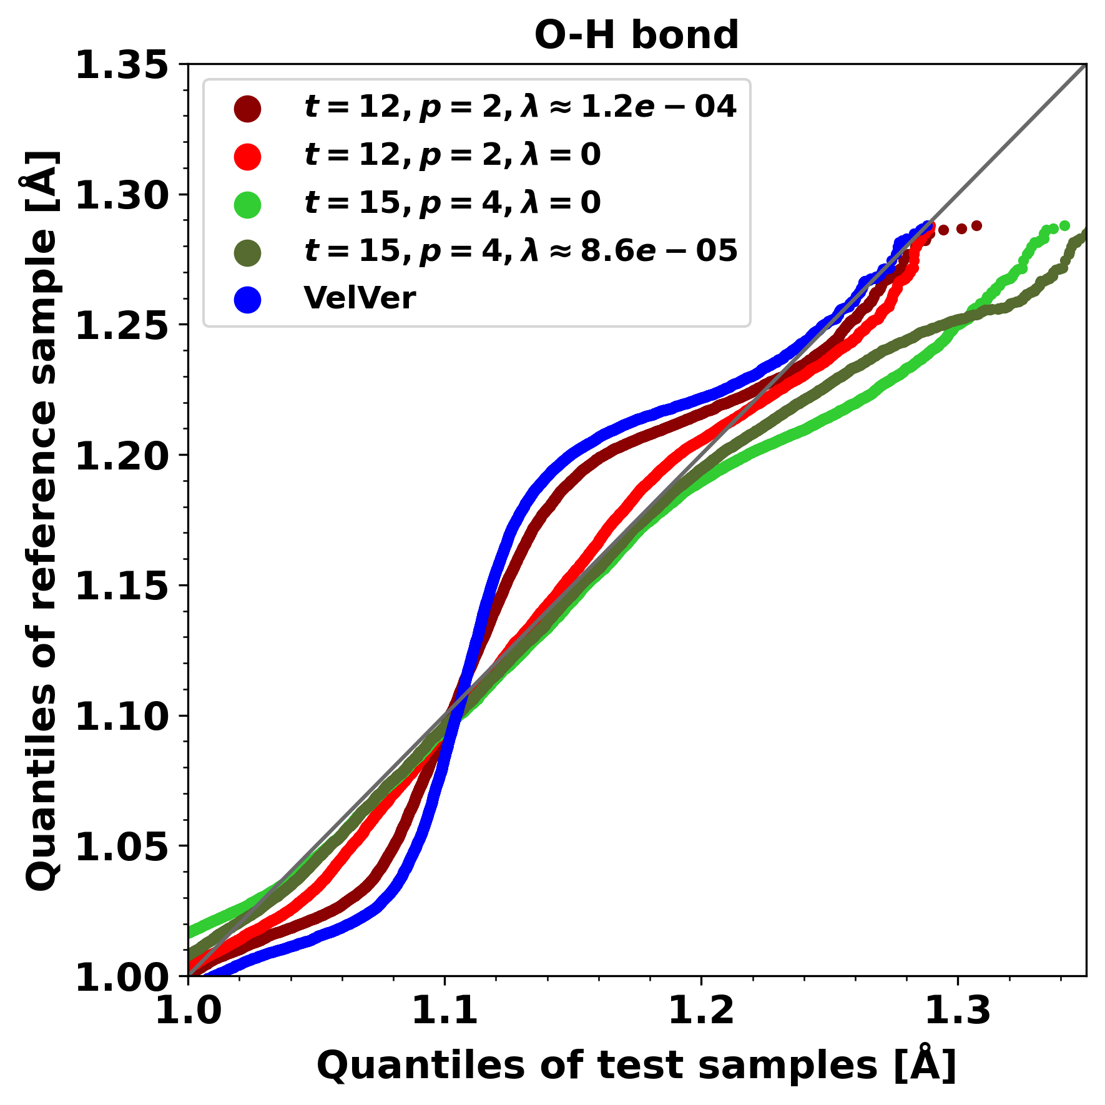
Appendix

Slide 48

Appendix

Slide 49

Appendix

Slide 50

Appendix

Slide 51

Appendix

Slide 52

Appendix

